Slide 1

DC-DC Converter for PV Module Integration
Group 760

Slide 2

CONTENT
INTRODUCTION
CONVERTER DESIGN
MPPT ALGORITHM
TESTS RESULTS
DISCUSSION
CONCLUSION

Slide 3
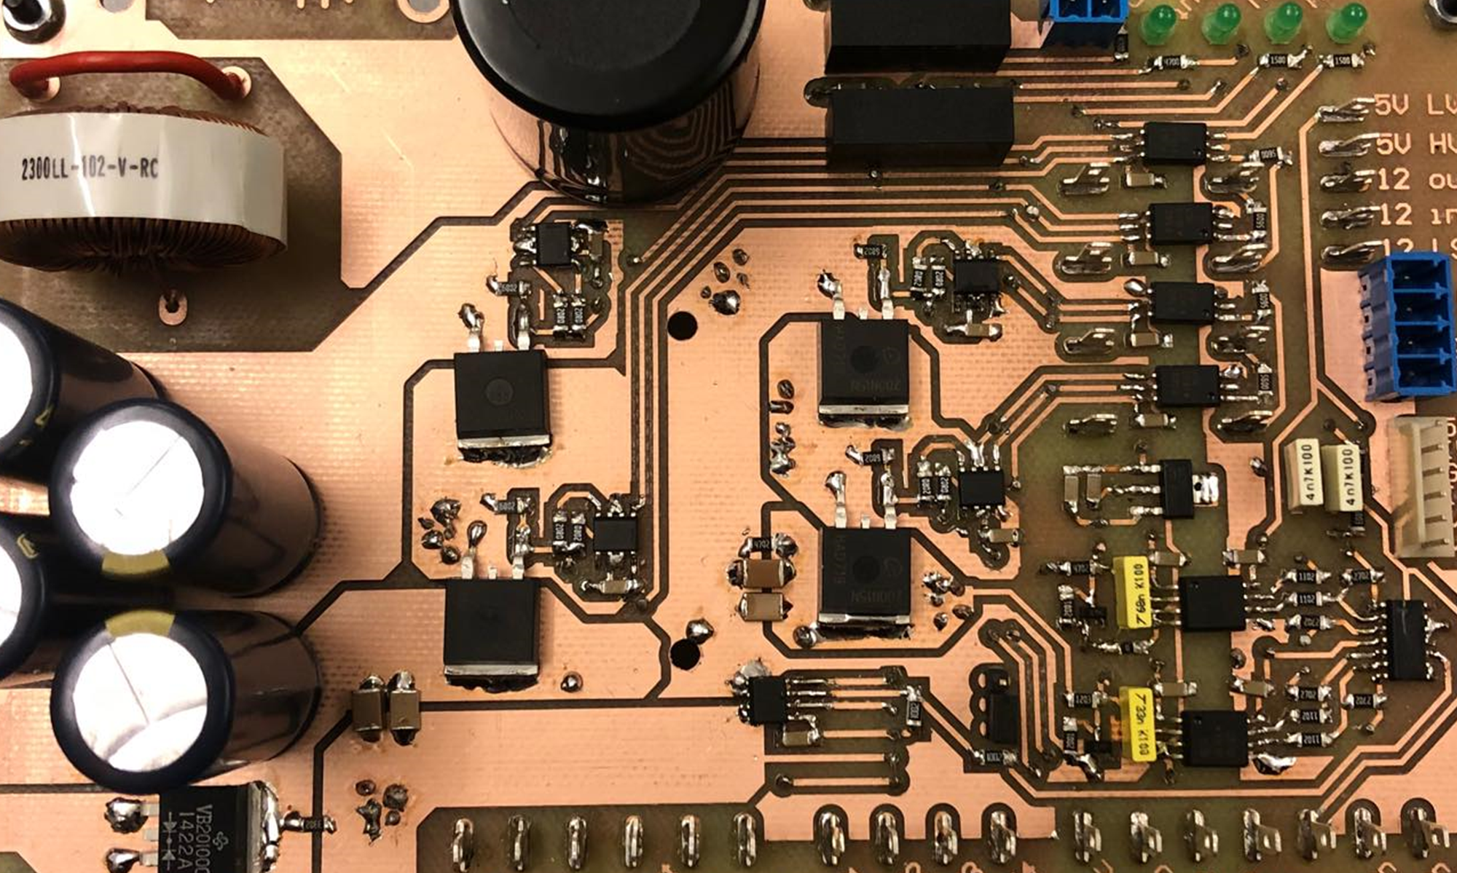
Introduction
Notes:
Motivation
Existing problems
What is a MIC
Why a MIC
Problem statement

Slide 4
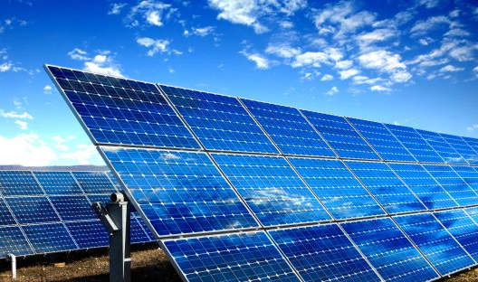
Motivation
Slide
of 59
Global need of transition towards clean energy.
Wind and solar energy production as fastest growing method in 2017.
Improve current generation efficiencies.
PV array [1]
Aitor

Slide 5
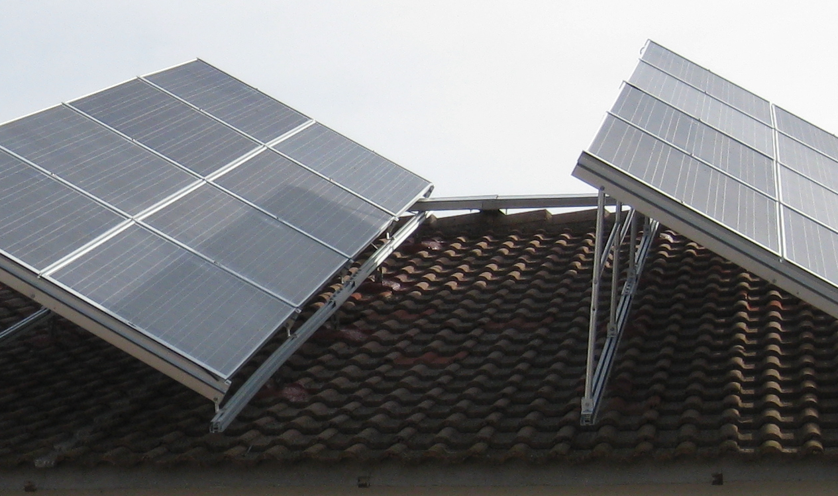
Existing problem
Slide
of 59
Power mismatches:
Production tolerances.
Partial shading.
Cracks.
Uneven aging.
Dirt.
Partial shaded PV panel [2]
Aitor

Slide 6
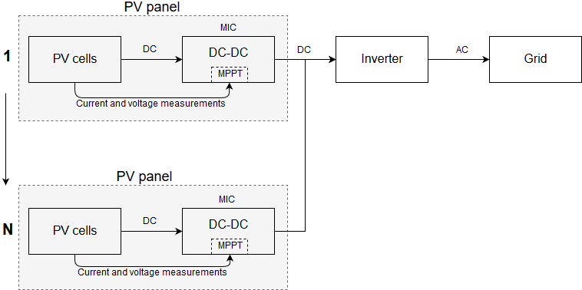
What is a module integrated converter (MIC)?
Slide
of 59
Is a part of each PV module.
Prevents mismatch losses.
Serial or parallel arrangements.
Aitor

Slide 7
Why MICs?
Slide
of 59
Advantages:
Allows individual maximum power point tracking.
Replaces bypass diode.
Higher system efficiencies achieved under mismatches.
Certain topologies allow bidirectionality.
Disadvantages:
Could imply lower efficiency under specific cases.
Production cost increase.
Aitor

Slide 8
Problem statement and objectives
Slide
of 59
How can a module integrated converter be designed to maximize
the PV power generation under real conditions?
Objectives:
Design a DC-DC converter for integration with a PV panel.
Implementation of an MPPT algorithm.
Hardware implementation of the MIC.
Test of the system and validation of the MIC.
Aitor

Slide 9
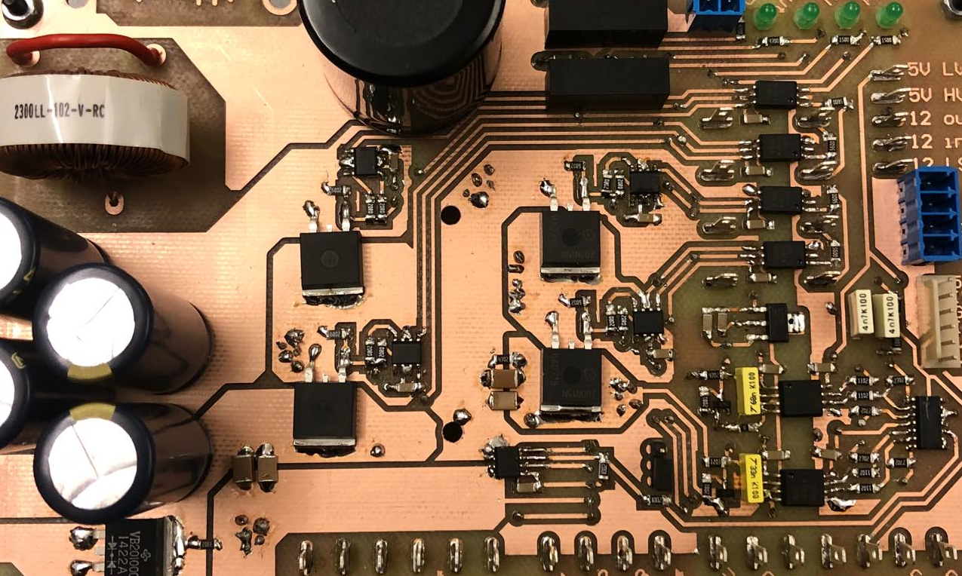
Converter Design

Slide 10
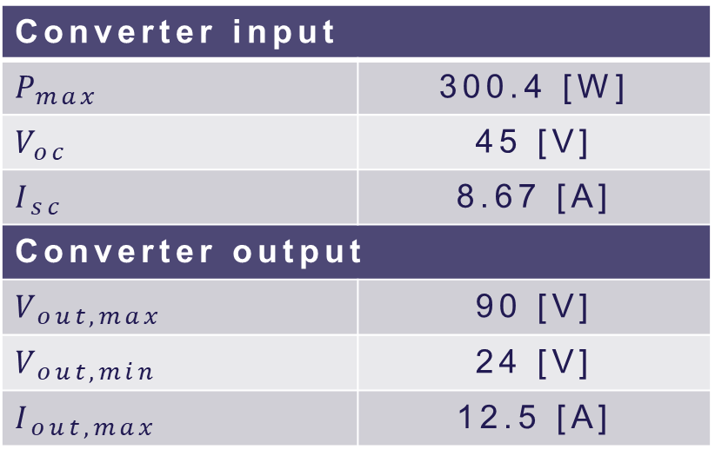
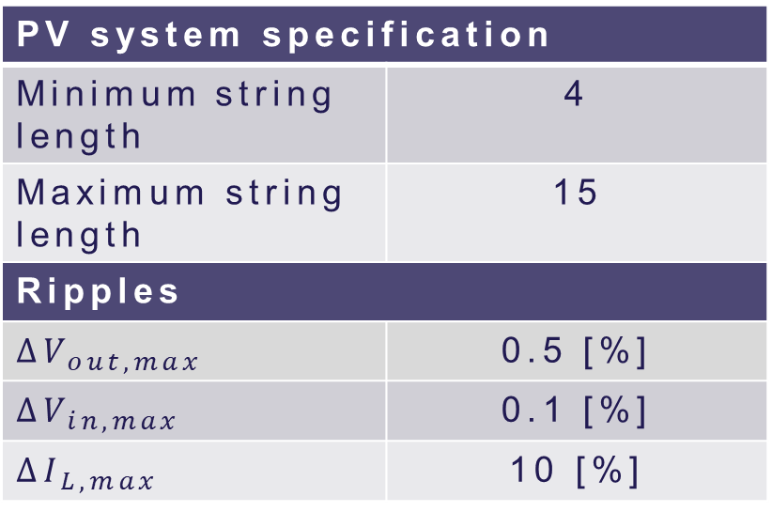
System requirements
Slide
of 59
Converter input
$$P_{max}$$ | 300.4 [W]
$$V_{oc}$$ | 45 [V]
$$I_{sc}$$ | 8.67 [A]
Converter output
$$V_{out,max}$$ | 90 [V]
$$V_{out,min}$$ | 24 [V]
$$I_{out,max}$$ | 12.5 [A]
PV system specification
Minimum string length | 4
Maximum string length | 15
Ripples
$$∆V_{out,max}$$ | 0.5 [%]
$$∆V_{in,max}$$ | 0.1 [%]
$$∆I_{L,max}$$ | 10 [%]
Nicolai
Notes:
How did we select the values
Input from PV panel
Output from inverter voltage and # of panels
# of panels from minimum and maximum duties
Ripples so we dont mess with the PV panel

Slide 11
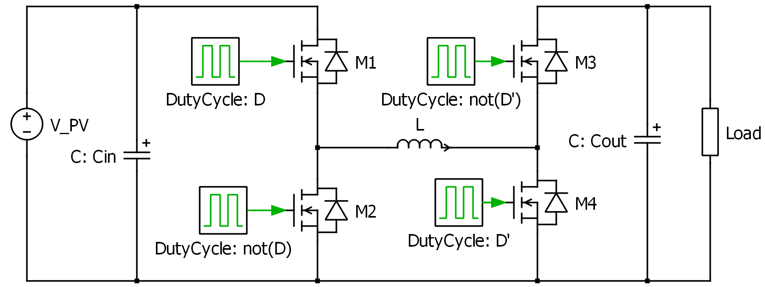
Selection of topology
Slide
of 59
Non-inverting buck-boost converter
Nicolai
Notes:
Capabilities of both higher and lower output voltage
2 or 4 MOSFETs
Bidirectional opportunities
Lower (conduction) losses

Slide 12
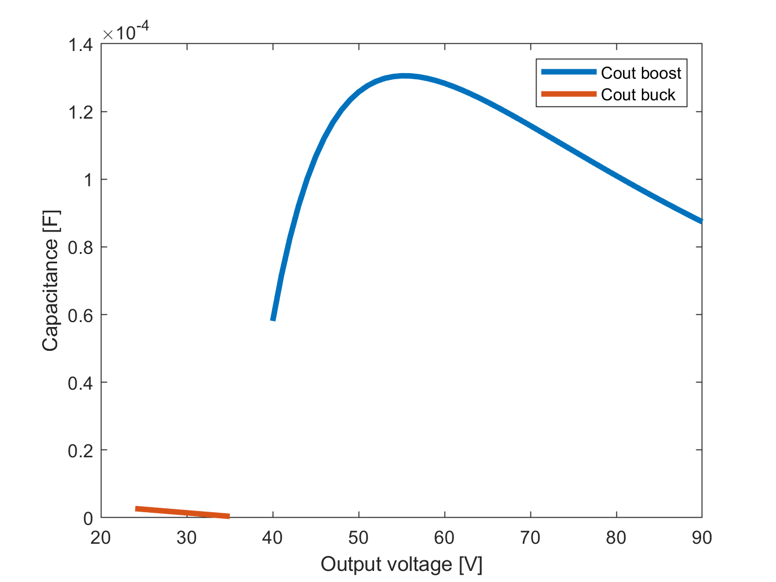
Passive components Sizing
Slide
of 59
Calculated using the ripples.
Finding worst case conditions.
Depends on switching frequency.
Output capacitor
Nicolai
Notes:
Did a voltage sweep to determine worst case

Slide 13
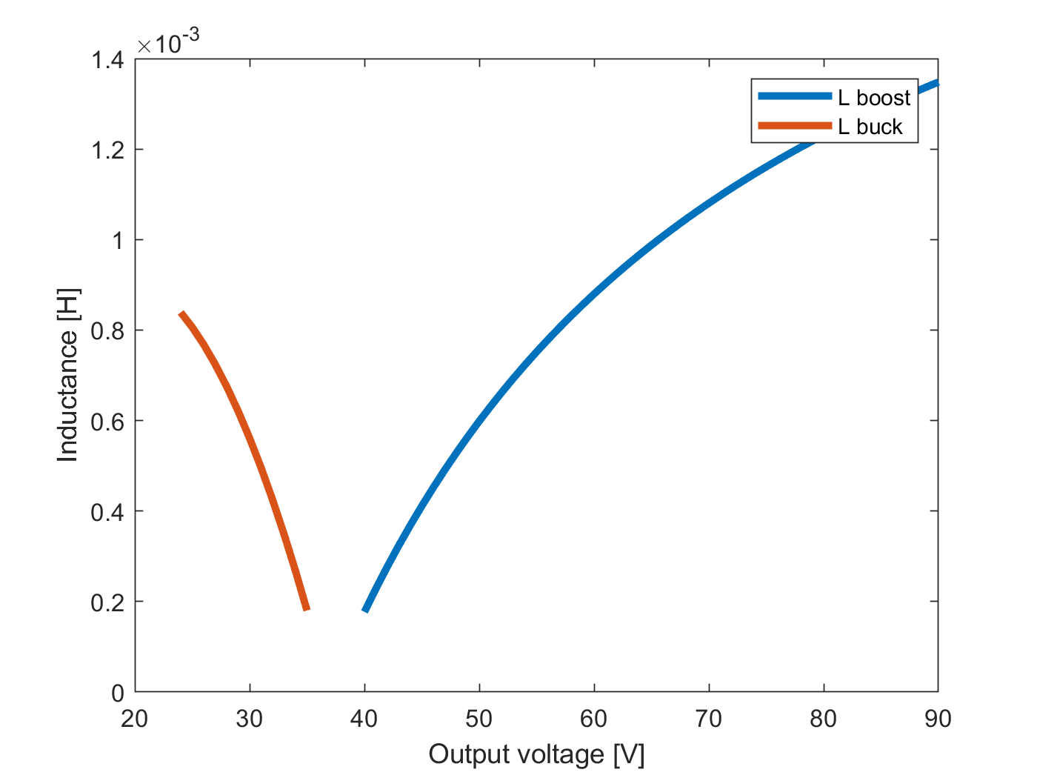
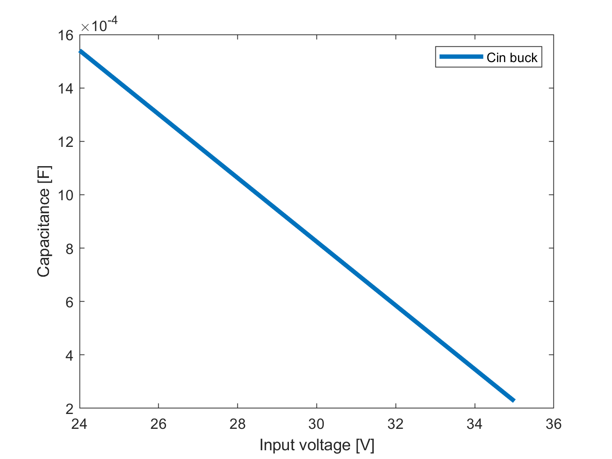
Passive components Sizing
Slide
of 59
Inductor
Input capacitor
Nicolai

Slide 14
Passive components Selection
Slide
of 59
Minimum 20% margin was included.
Reused inductor.
Component | Theoretical value | Implemented value | Voltage rating
Input capacitor | 1540µF | 1880µF | 100V
Output capacitor | 130µF | 820µF | 250V
Inductor | 1.3mH | 1.93mH | -
Nicolai
Notes:
Input cap is 4*470uF
Calculation mistakes lead to wrongly selected cout

Slide 15
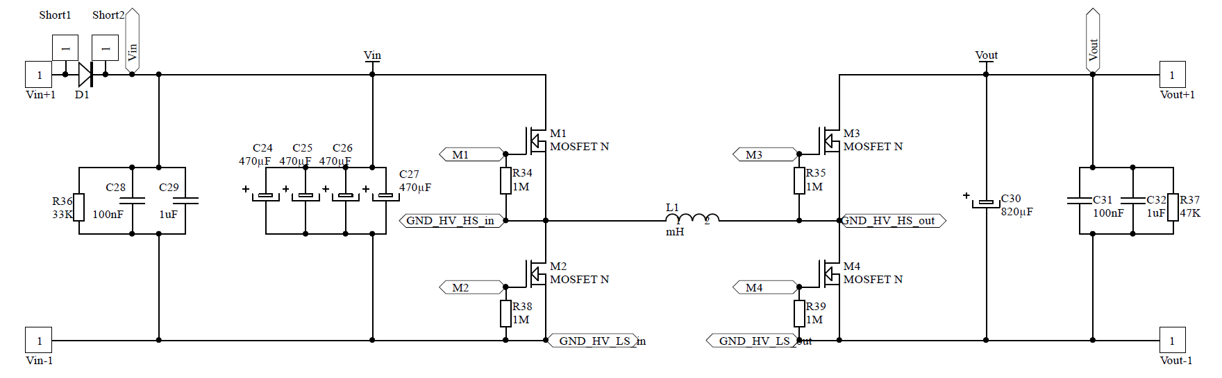
Power circuitry
Slide
of 59
High frequency capacitors.
Discharging resistors.
Protection diodes.
Nicolai

Slide 16
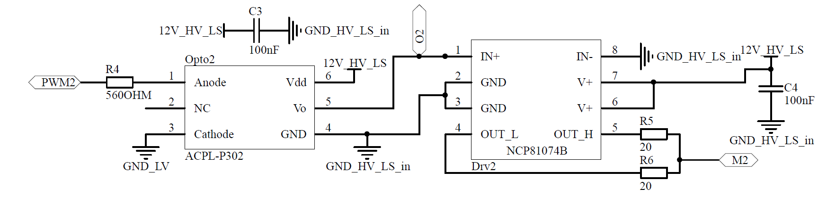
Driving circuitry
Slide
of 59
Optocouplers for isolation.
Current limiting resistors.
Decoupling capacitors.
Nicolai

Slide 17
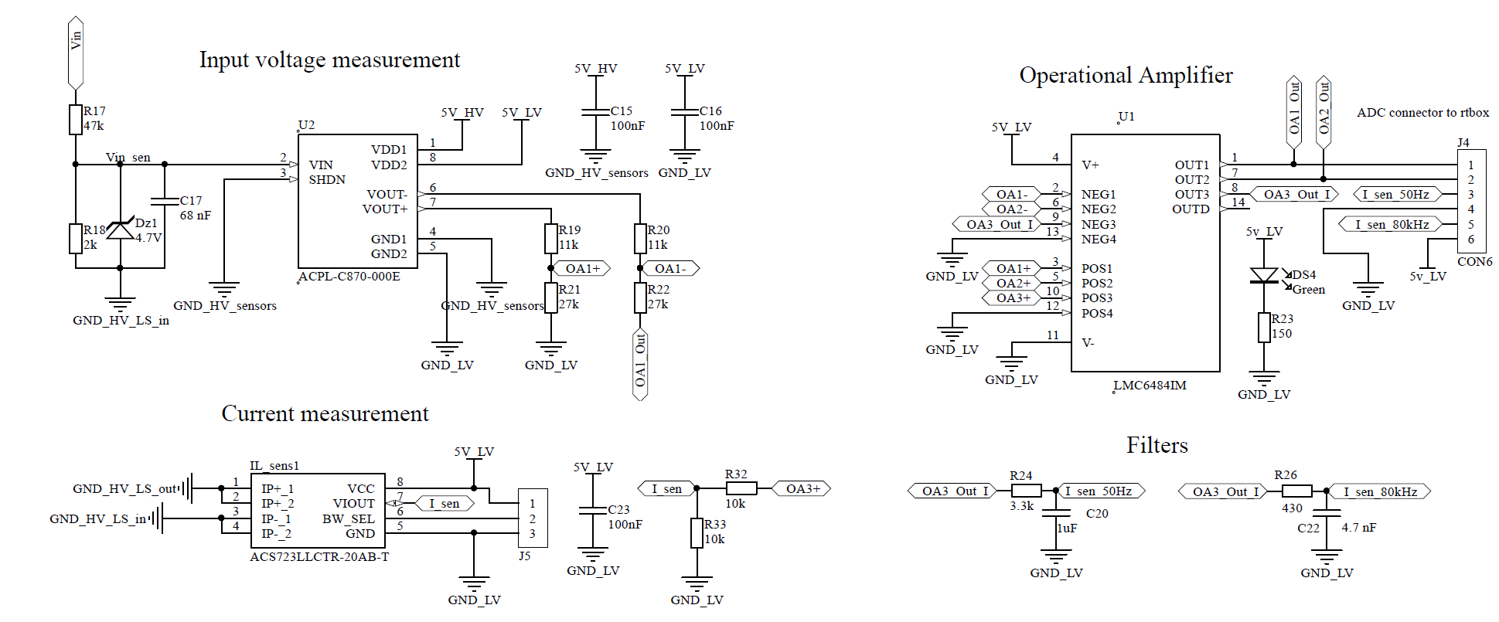
Sensor circuitry
Slide
of 59
Nicolai
Notes:
Optical unity-gain amplifier – voltage sensors
Hall effect – current sensor

Slide 18
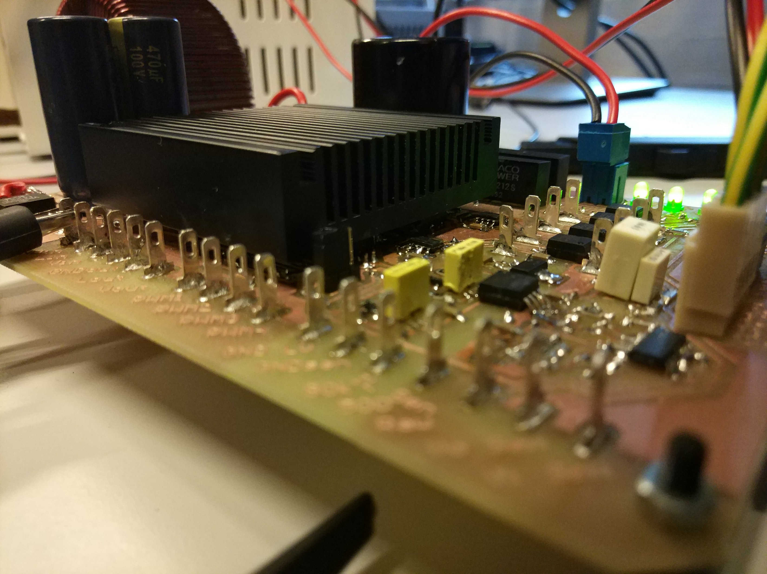
Power supplies
Slide
of 59
External supplies.
Isolated 12V TRACO supplies.
Linear 5V voltage regulator.
LED at every supply line.
Nicolai

Slide 19
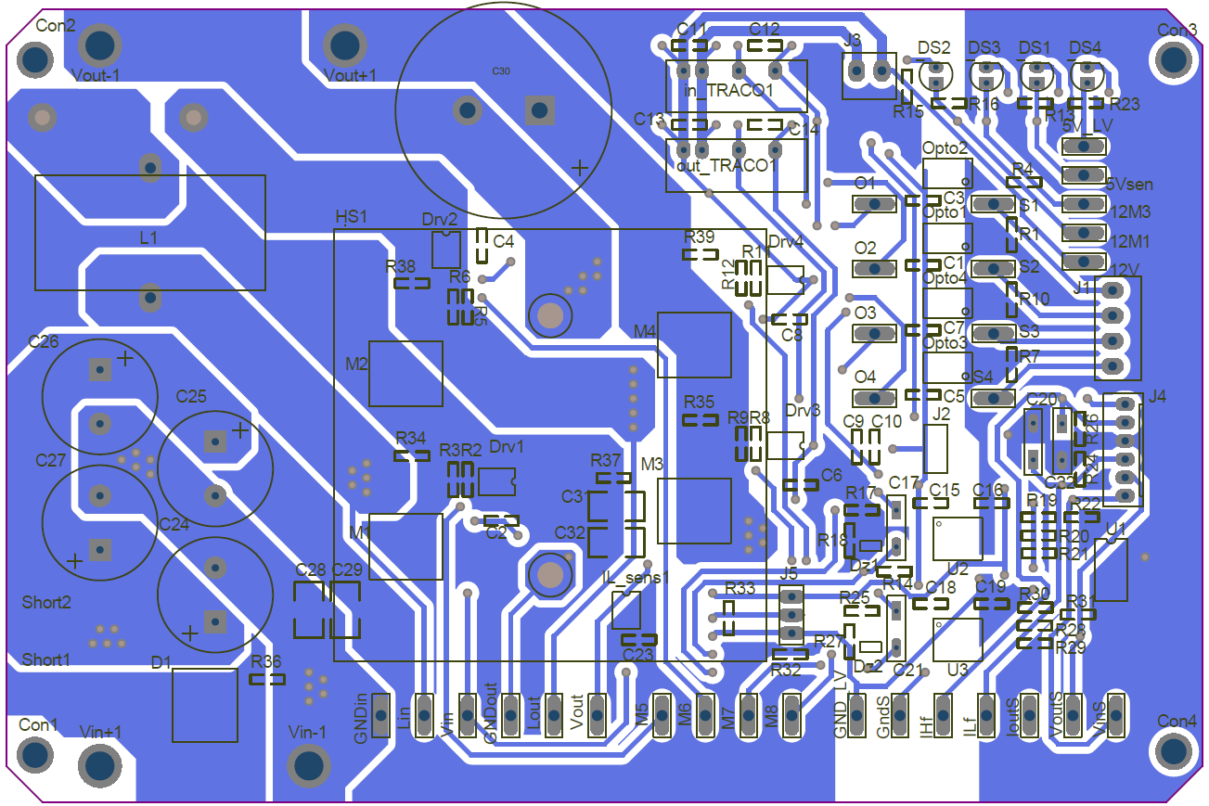
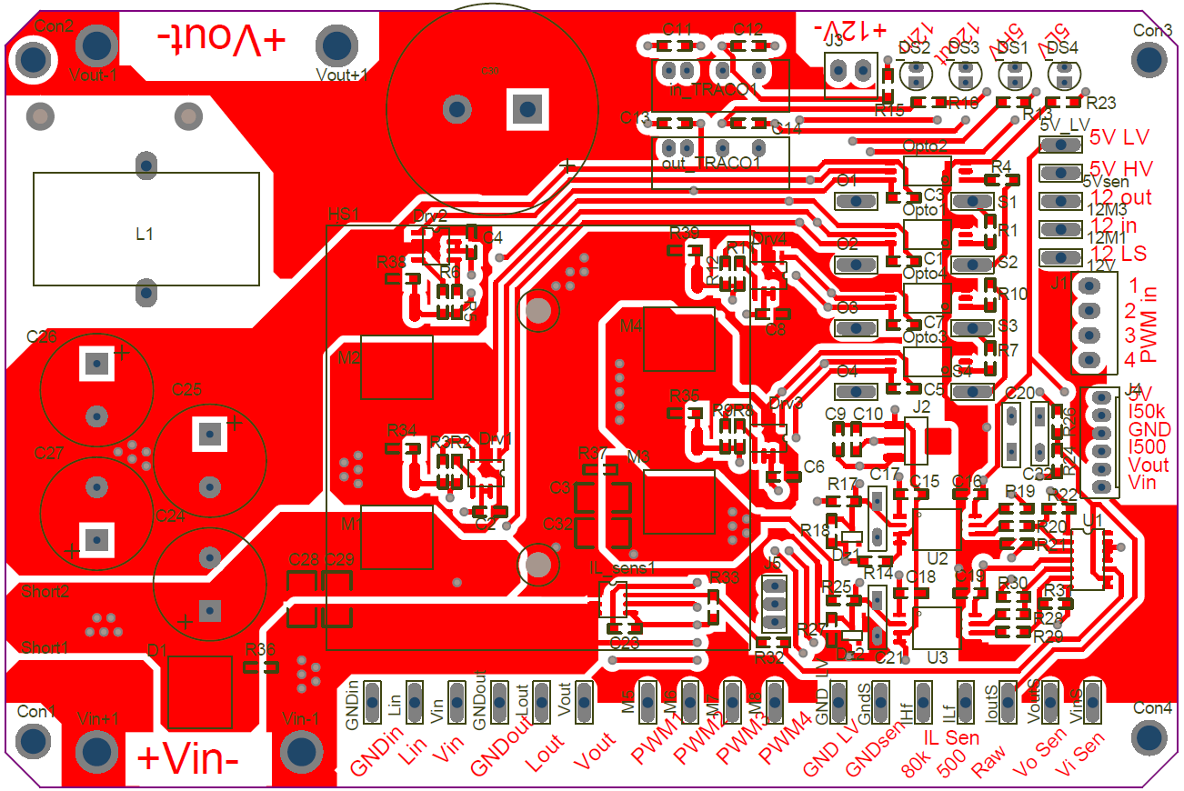
PCB layout
Slide
of 59
Considerations:
Hot and cold sides.
Isolations.
EMI - EMC.
Others.
Aitor

Slide 20
Hot and cold sides
Slide
of 59
Clear separation of hot and cold sides.
Power side.
Control side, non-isolated.
Control side, isolated.
Aitor

Slide 21
EMI - EMC
Slide
of 59
Reduced current loops.
Hall sensor location.
Ground planes.
Aitor

Slide 22
Others
Slide
of 59
Test points.
Other measuring points and user communication.
Heat sink location.
10mm power traces.
Aitor

Slide 23
MPPT Algorithm

Slide 24
Maximum power point (MPP)
Slide
of 59
PV panel characteristic [3]
Thassilo

Slide 25
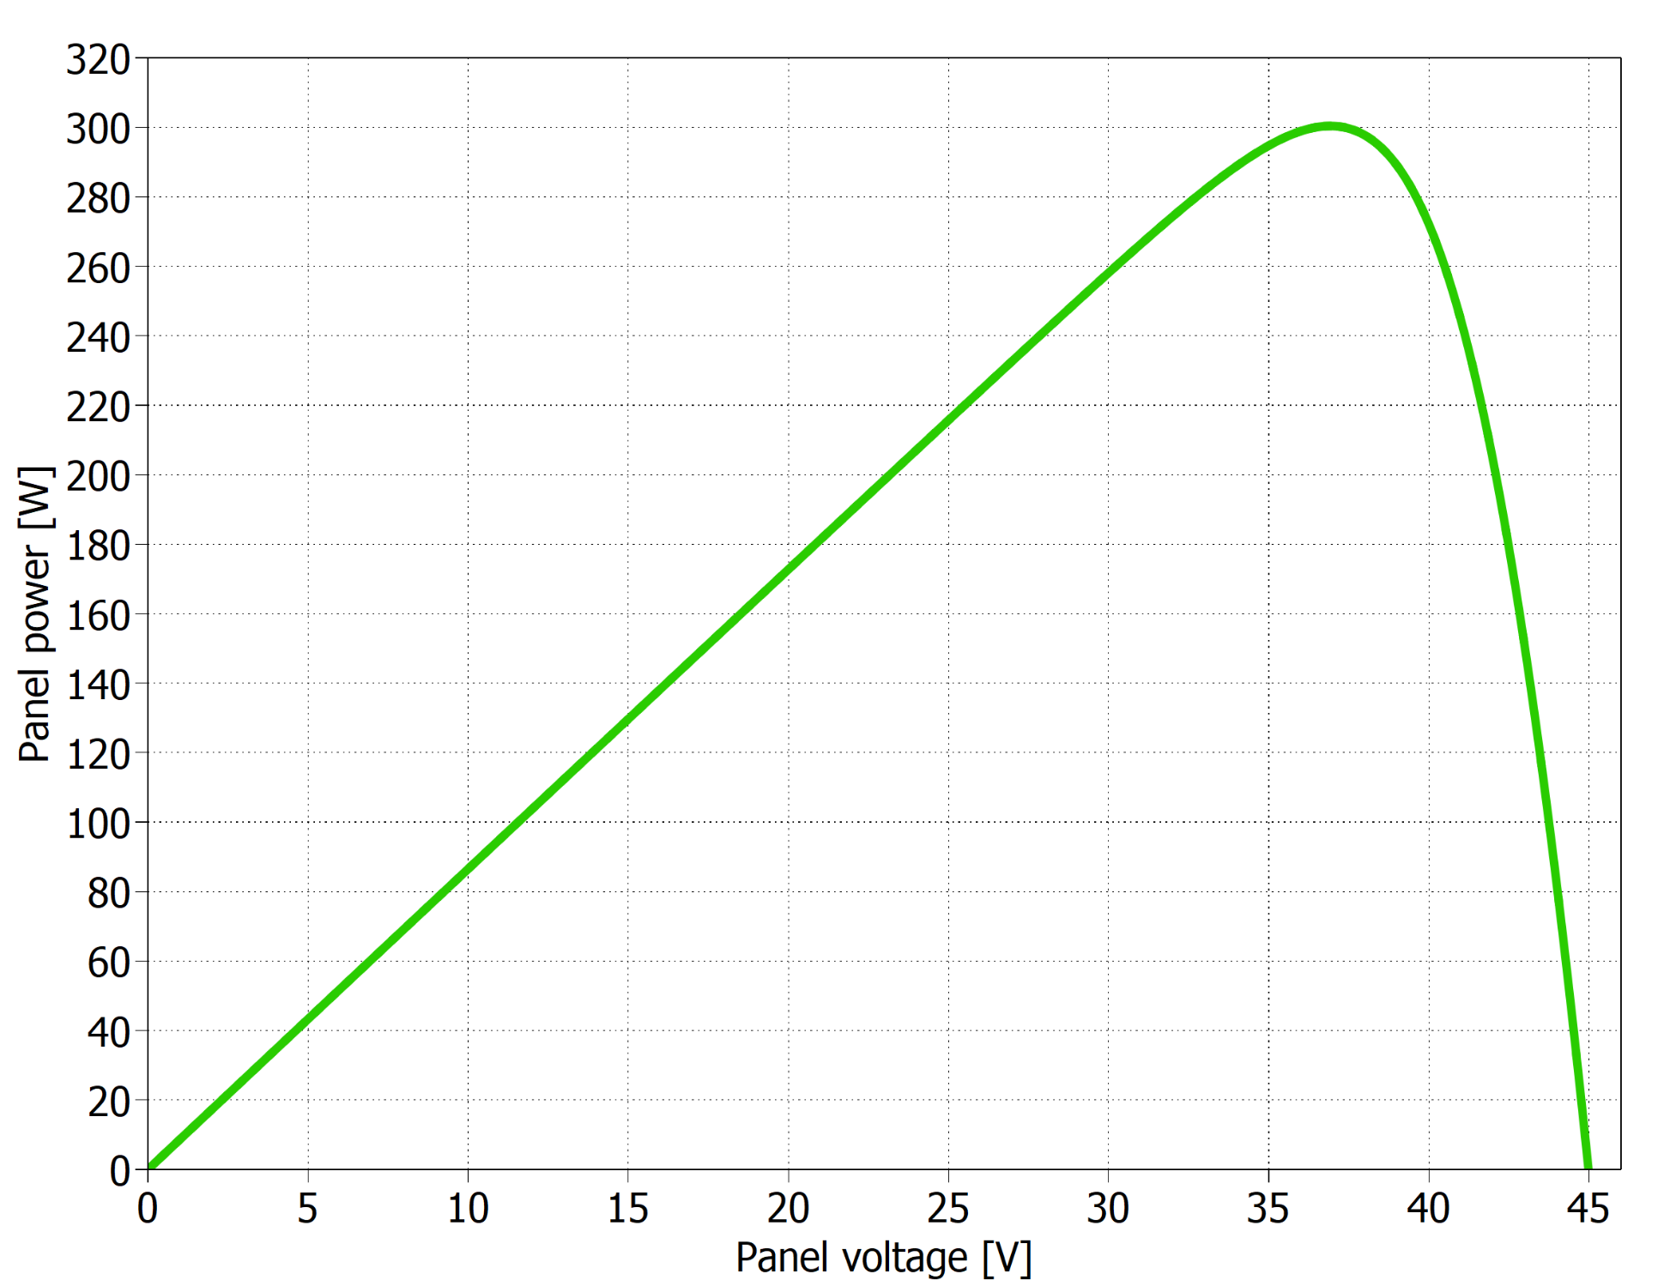
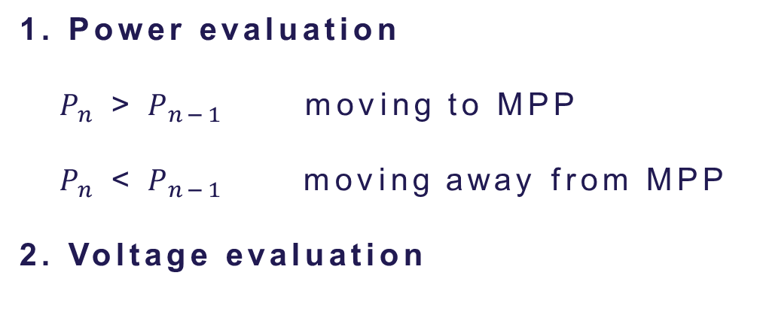
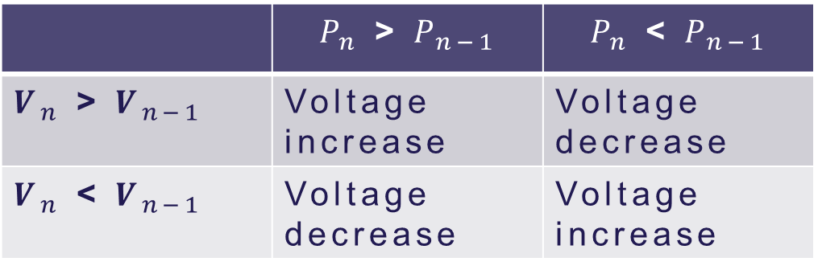
Perturb & Observe technique
Slide
of 59
1. Power evaluation
$P_{n}$ > $P_{n−1}$ moving to MPP
$P_{n}$ < $P_{n−1}$ moving away from MPP
2. Voltage evaluation
 | $P_{n}$ > $P_{n−1}$ | $P_{n}$ < $P_{n−1}$
$V_{n}$ > $V_{n−1}$ | Voltage increase | Voltage decrease
$V_{n}$ < $V_{n−1}$ | Voltage decrease | Voltage increase
P-V curve from a PV panel
Thassilo

Slide 26
Implementation
Slide
of 59
Block diagram of the system including the MPPT
Thassilo

Slide 27
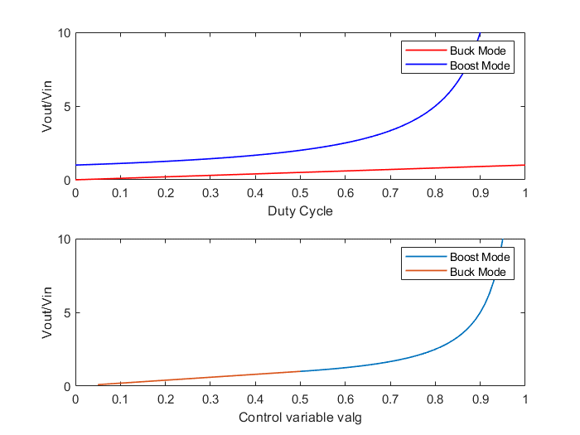

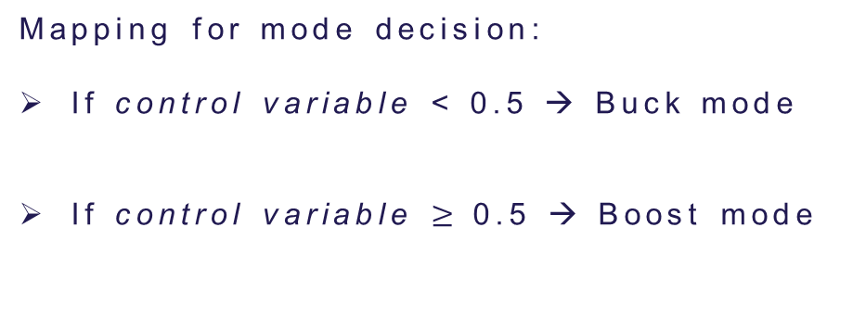
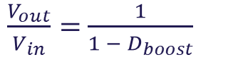
Initial MPPT implementation
Slide
of 59
$$\frac{V_{out}}{V_{in}}=D_{buck}$$
$\frac{V_{out}}{V_{in}}=$ $\frac{1}{1 − D_{boost}}$
Mapping for mode decision:
If control variable < 0.5 → Buck mode
If control variable $≥$0.5 → Boost mode
Top figure: Conversion ratio for buck and boost modes.
Bottom figure: Mapping of the control variable for mode decision.
Incrementing control variable means decreasing PV voltage!
Thassilo

Slide 28
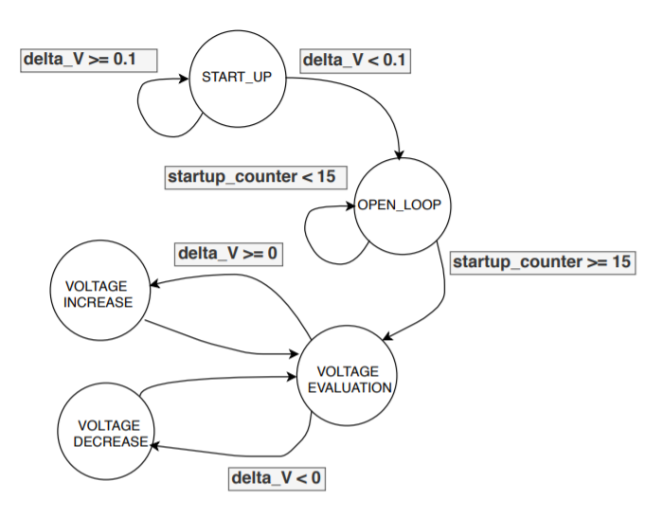

Initial MPPT implementation
Slide
of 59
Problems:
“If/else” structure difficult to find errors.
Variable step required more complex code.
Finite state machine for P&O algorithm
Thassilo

Slide 29
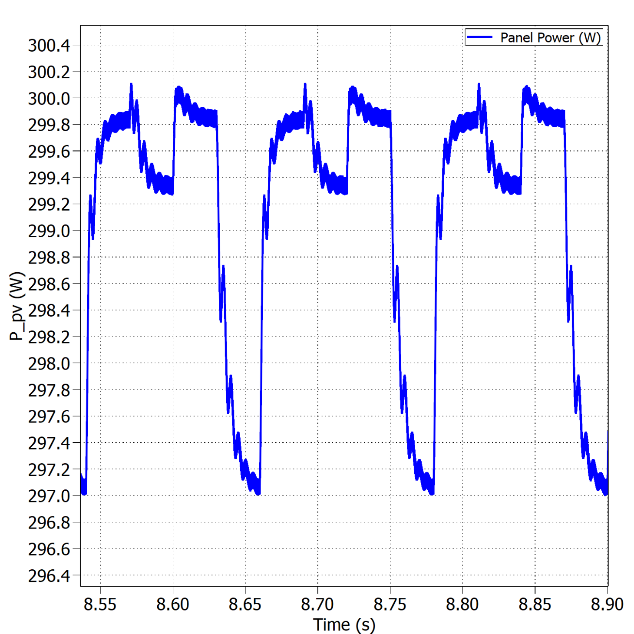
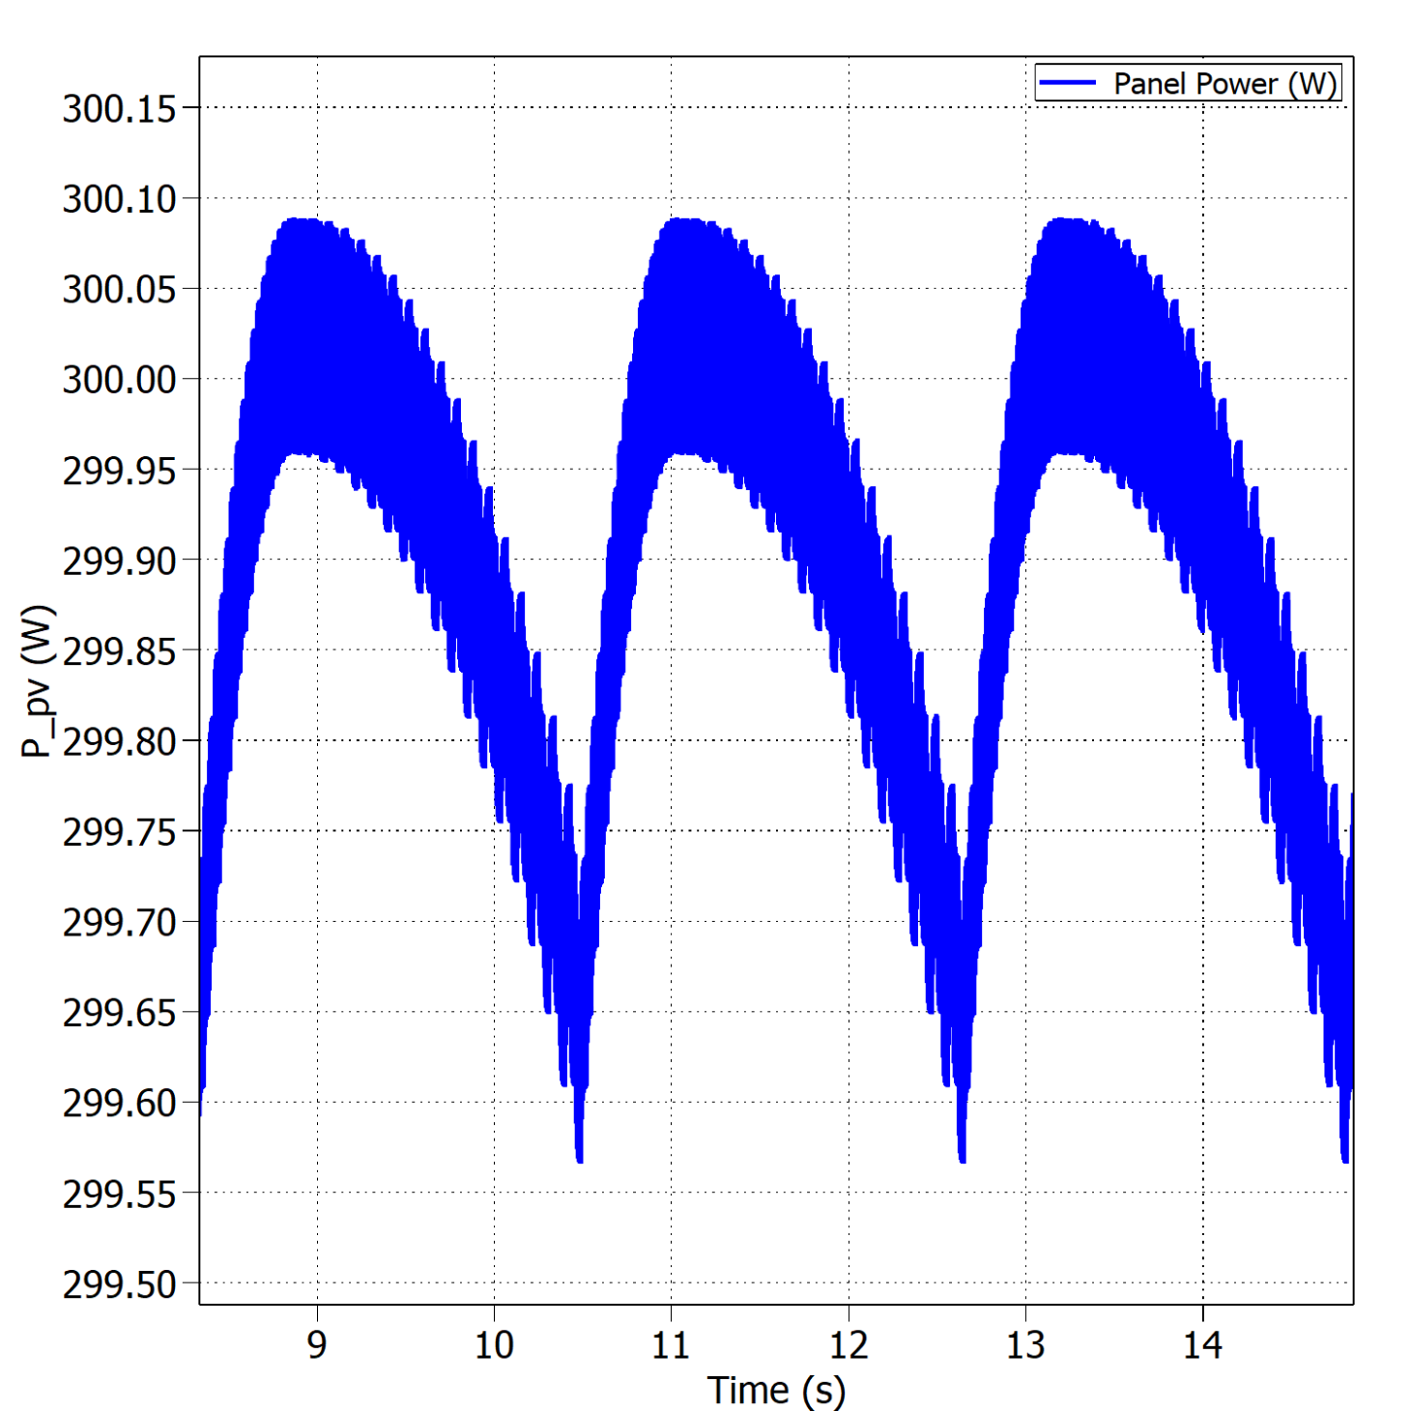


Fixed vs variable perturb step – Buck
Slide
of 59
Oscillations around the MPP with fixed perturb step under STC.
Oscillations around the MPP with variable perturb step under STC.
$$η_{MPPT}=99.38\%$$
$$η_{MPPT}=99.96\%$$
Thassilo

Slide 30
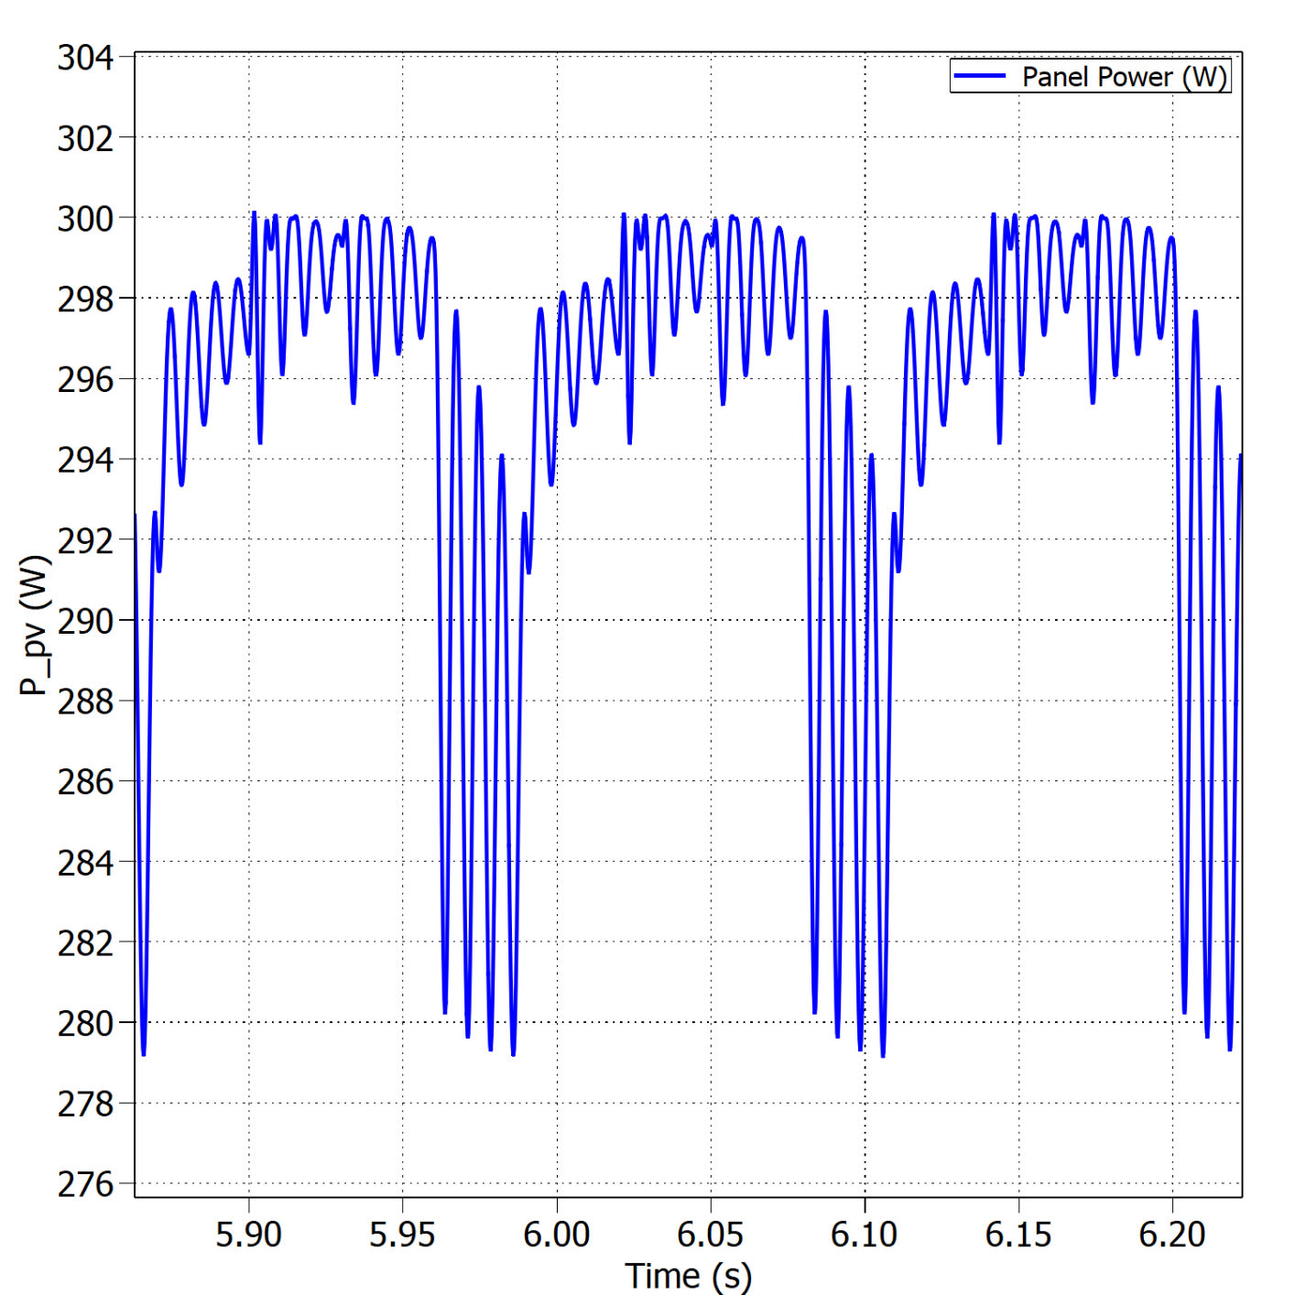
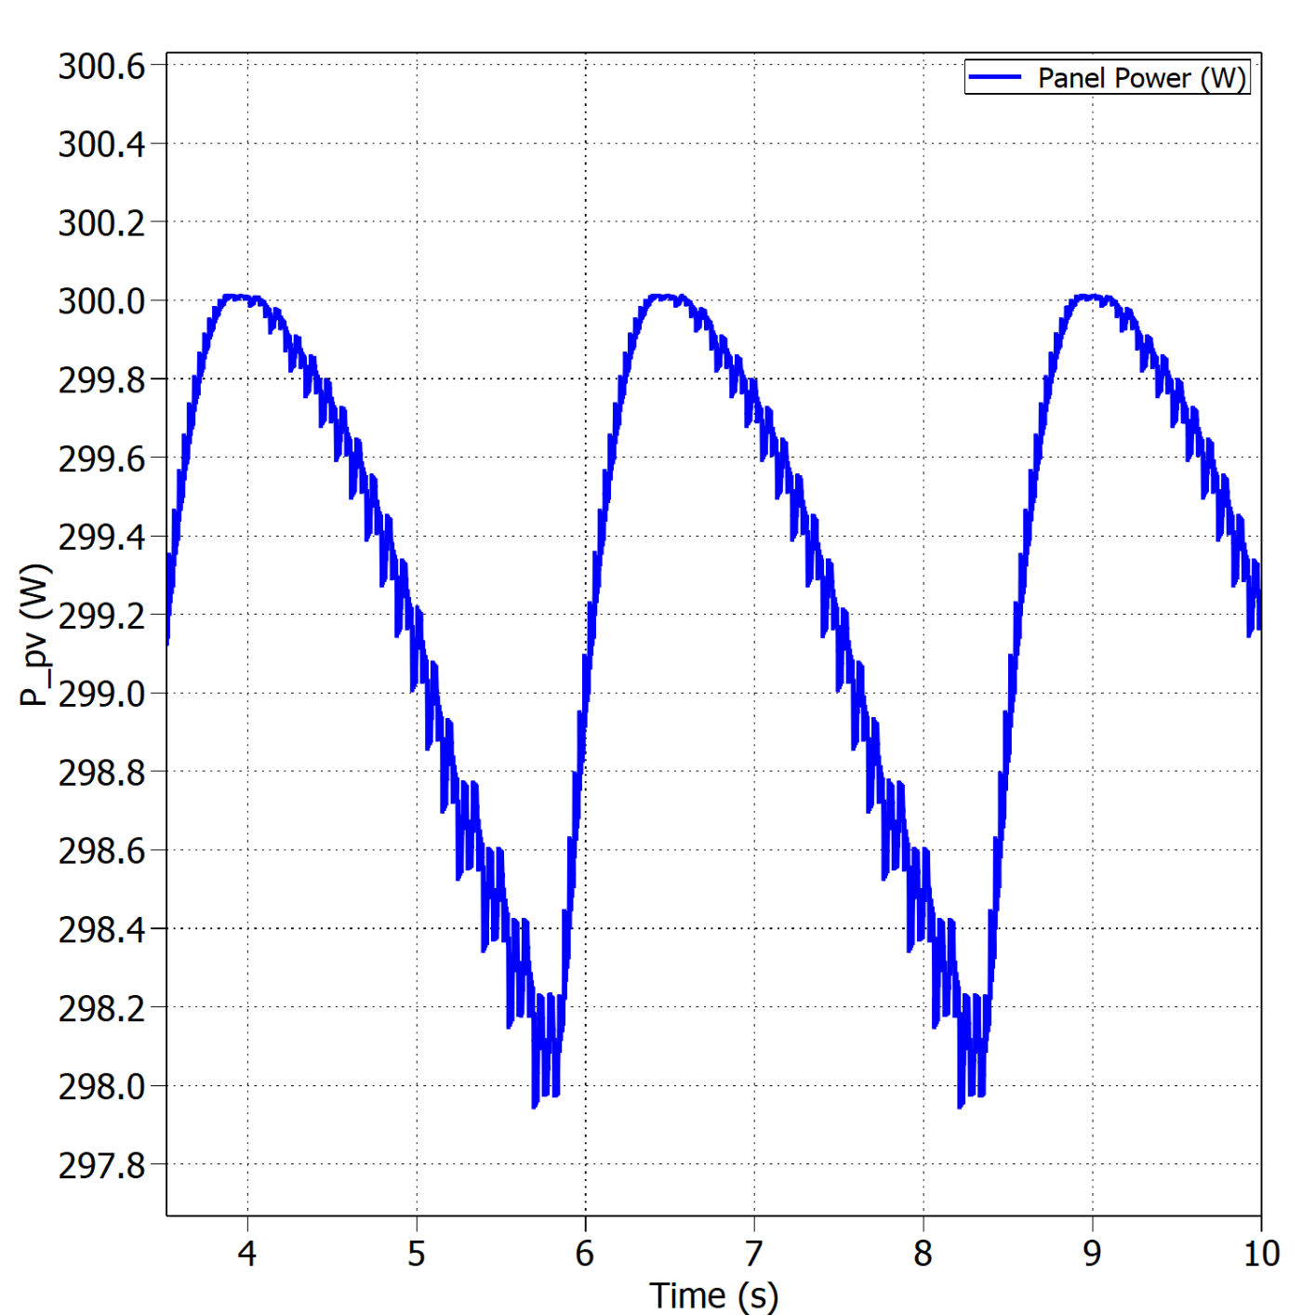


Fixed vs variable perturb step – Boost
Slide
of 59
Oscillations around the MPP with fixed perturb step under STC.
Oscillations around the MPP with variable perturb step under STC.
$$η_{MPPT}=96.40\%$$
$$η_{MPPT}=99.82\%$$
Thassilo

Slide 31
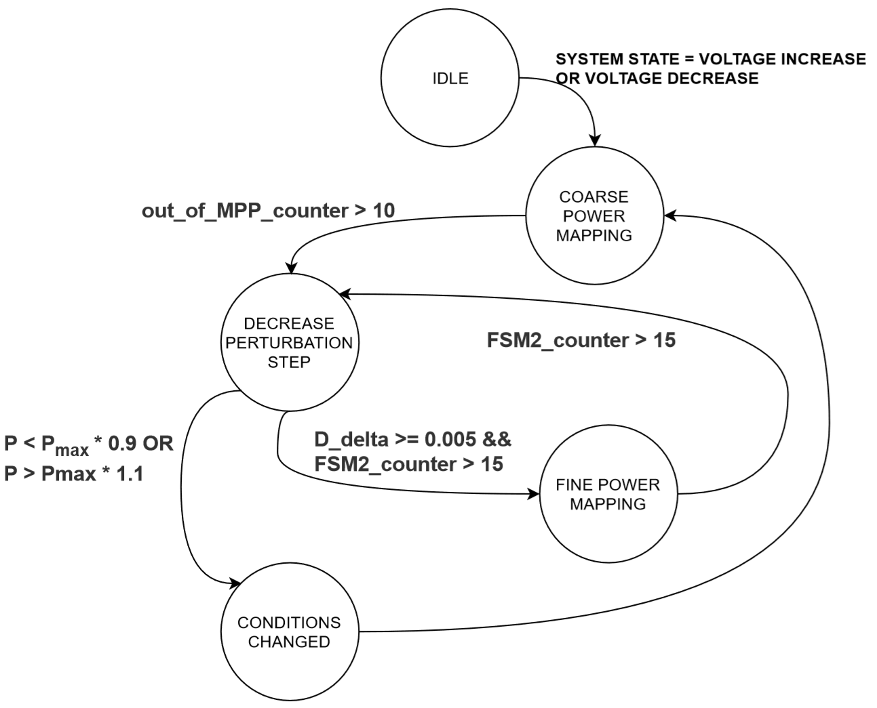
Final implementation
Slide
of 59
Main issues:
Measurements were read too fast.
Perturb step decreased after false positive MPP detection.
Environmental variables’ changes.
Nicolás

Slide 32



Final implementation
Slide
of 59
Pmax
Vmax
$$V_{MPP}$$
$$V_{MPP2}$$
Perturbation step & condition
change detection FSM
Nicolás

Slide 33
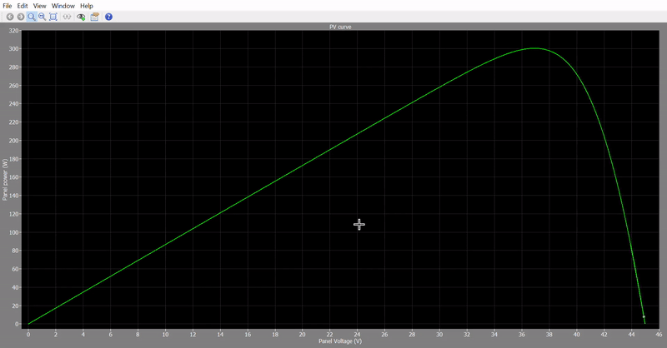
Final implementation
Slide
of 59
3 seconds sim time
Boost, 8 panels
Nicolás

Slide 34
Converter Design
Test Results

Slide 35
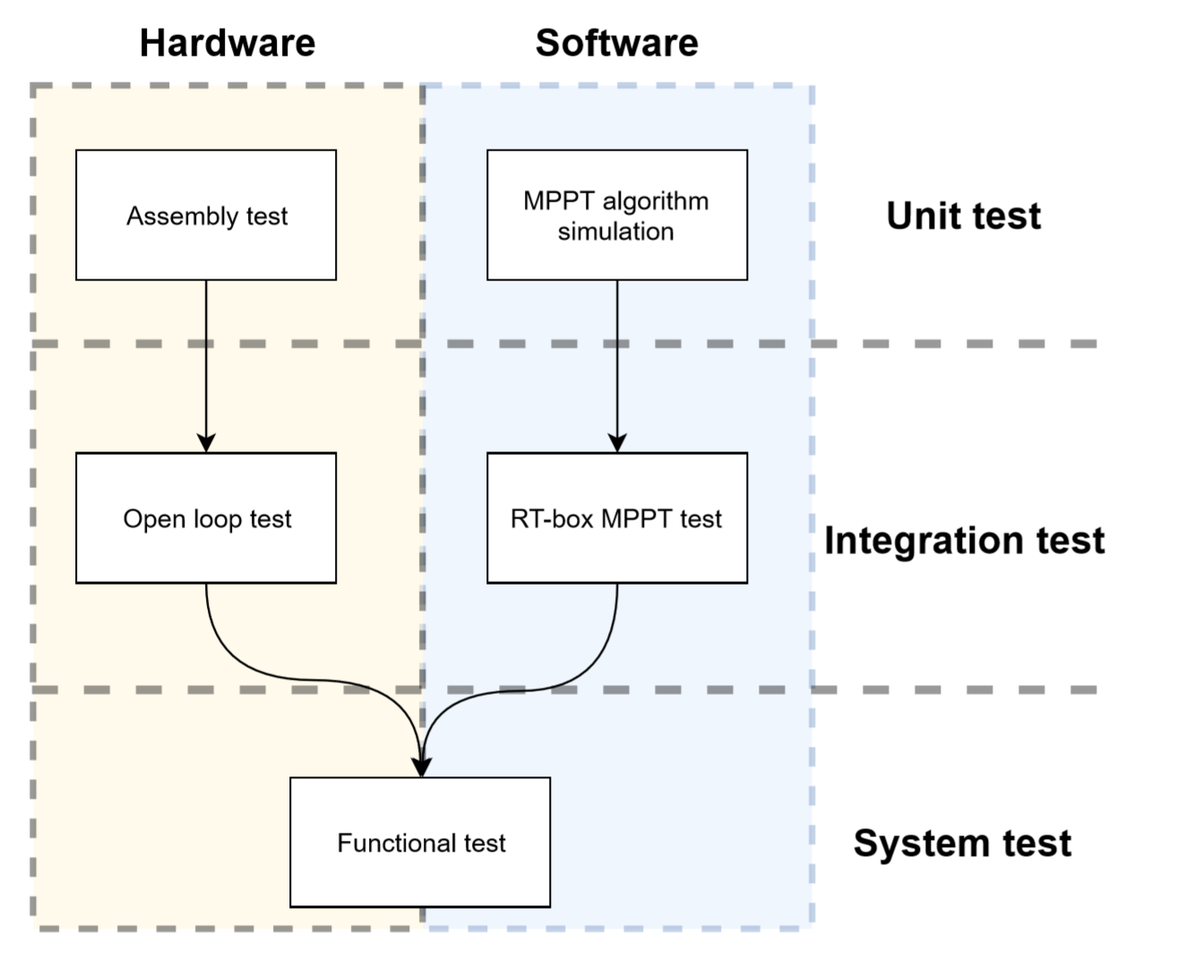
Testing Overview
Slide
of 59
Model of the PV panel.
Standard test conditions.
Boundary between modes of operation.
Sudden changes in environmental.
Converter’s efficiency.
…
Nicolás

Slide 36
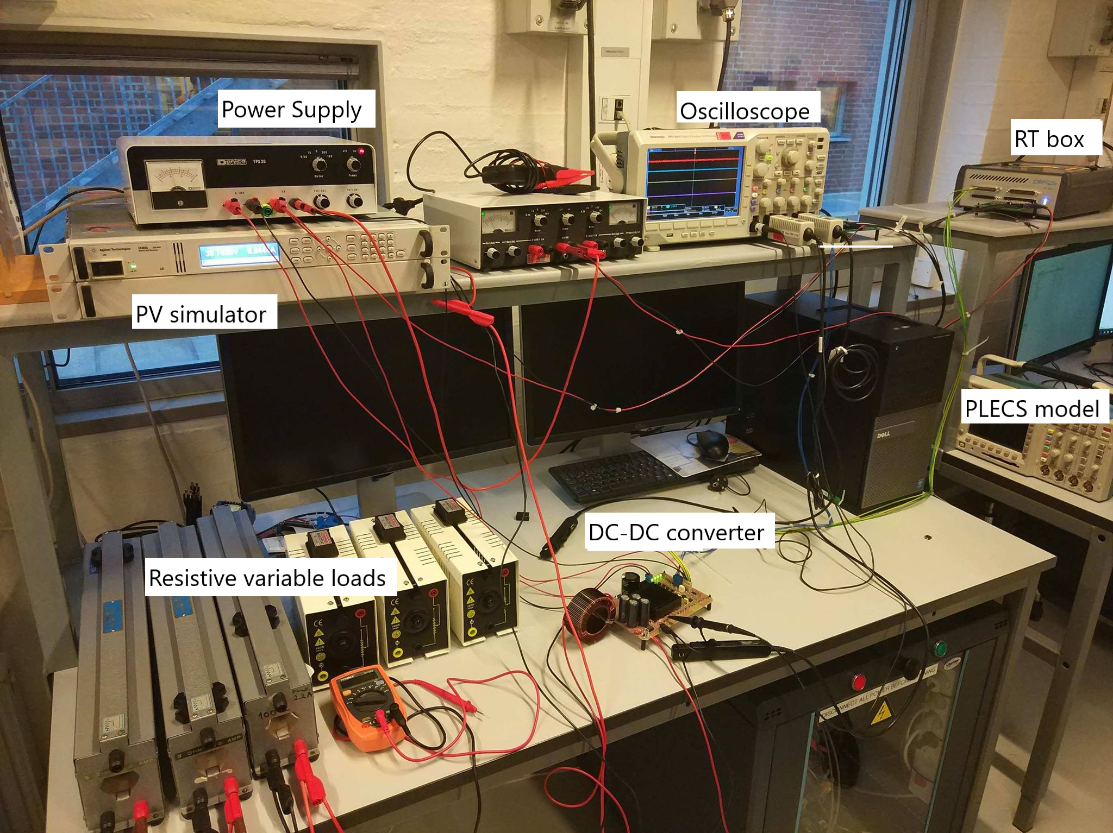
Test setup
Slide
of 59
Estefanía

Slide 37
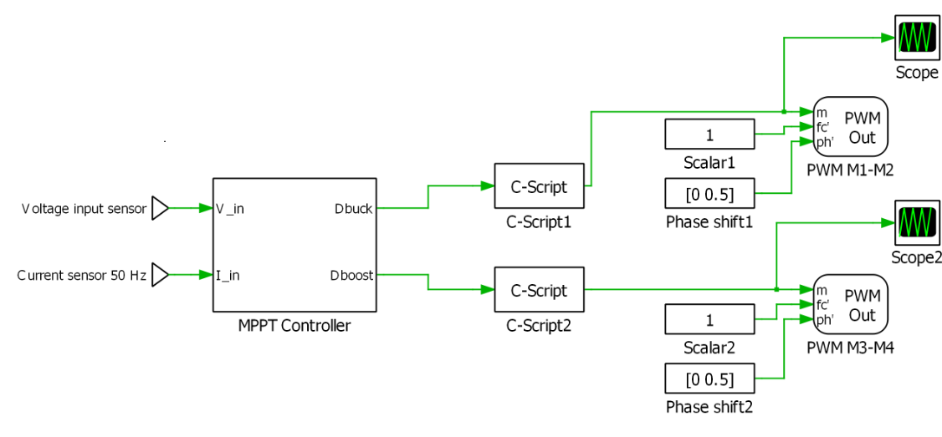
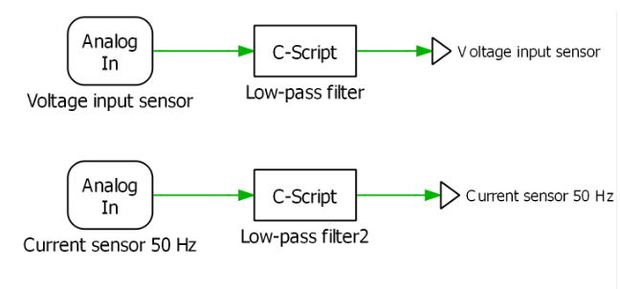
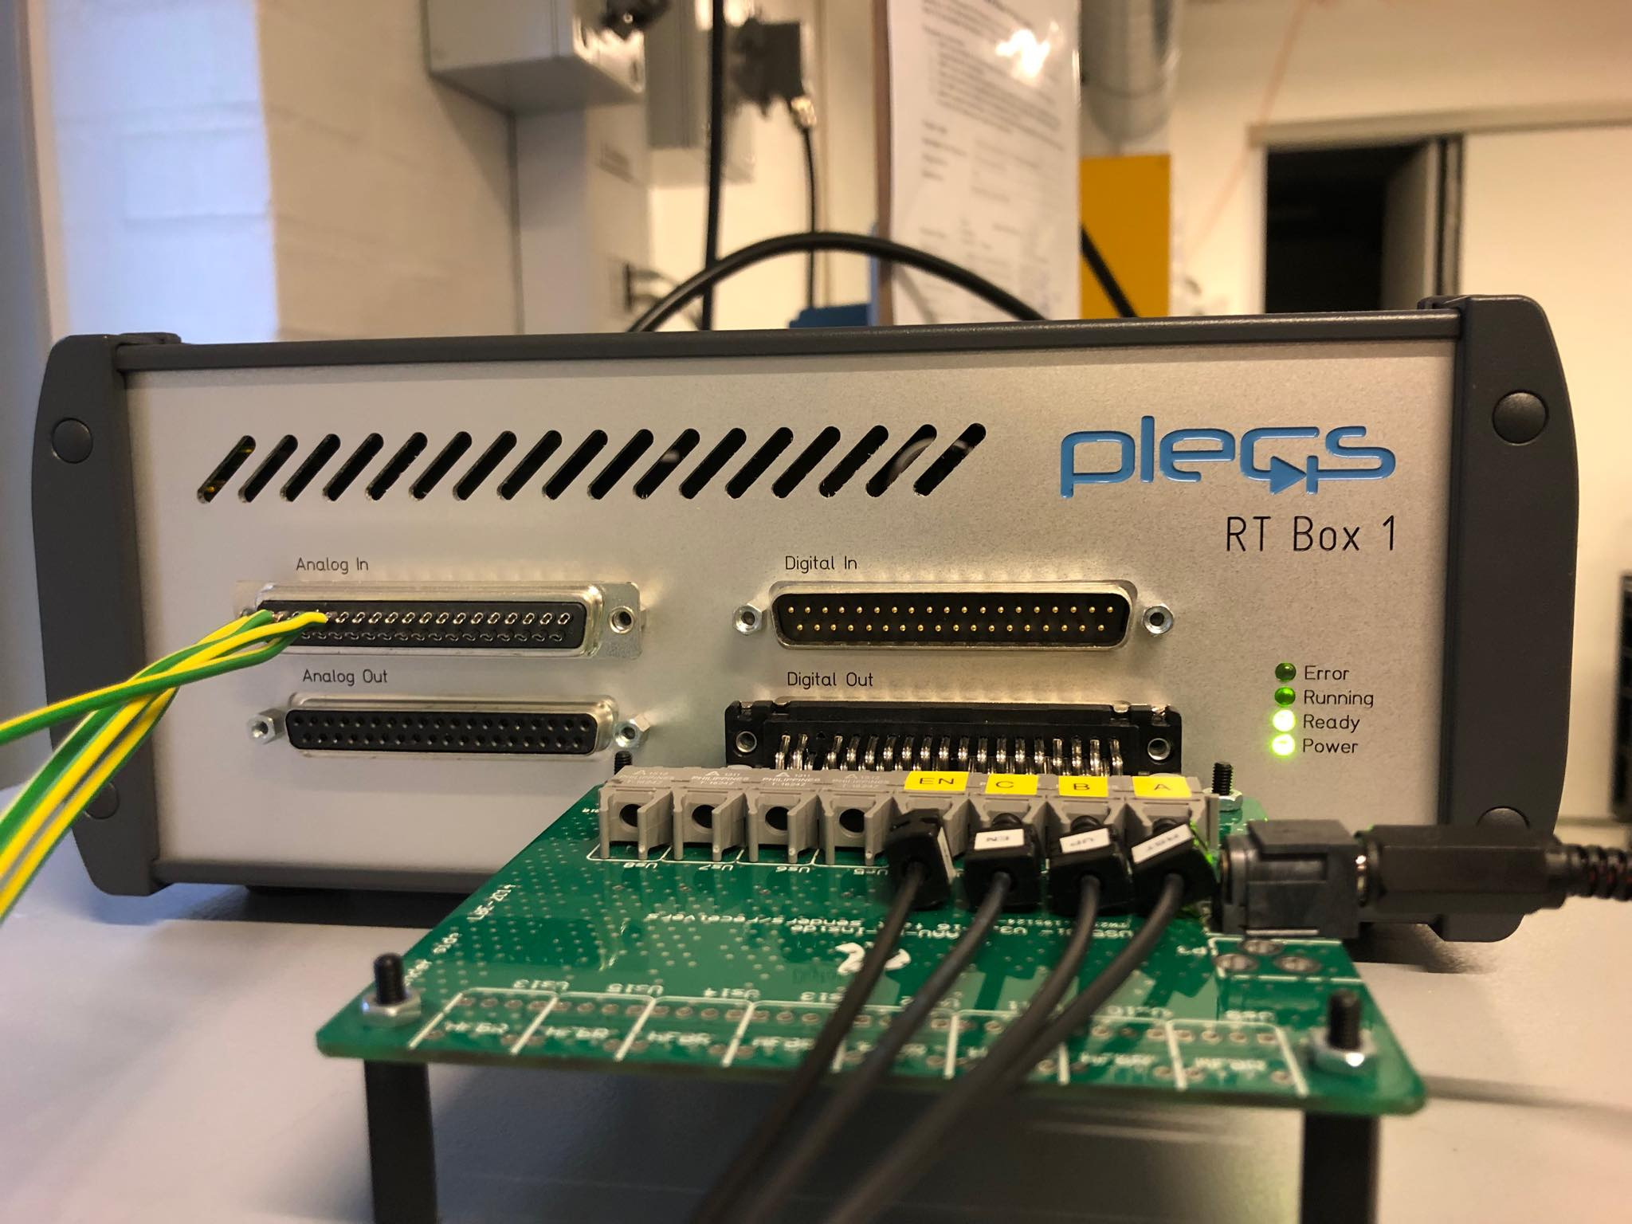
Test setup
Slide
of 59
RT Box:
PLECs model for interface with the RT Box.
Estefanía

Slide 38
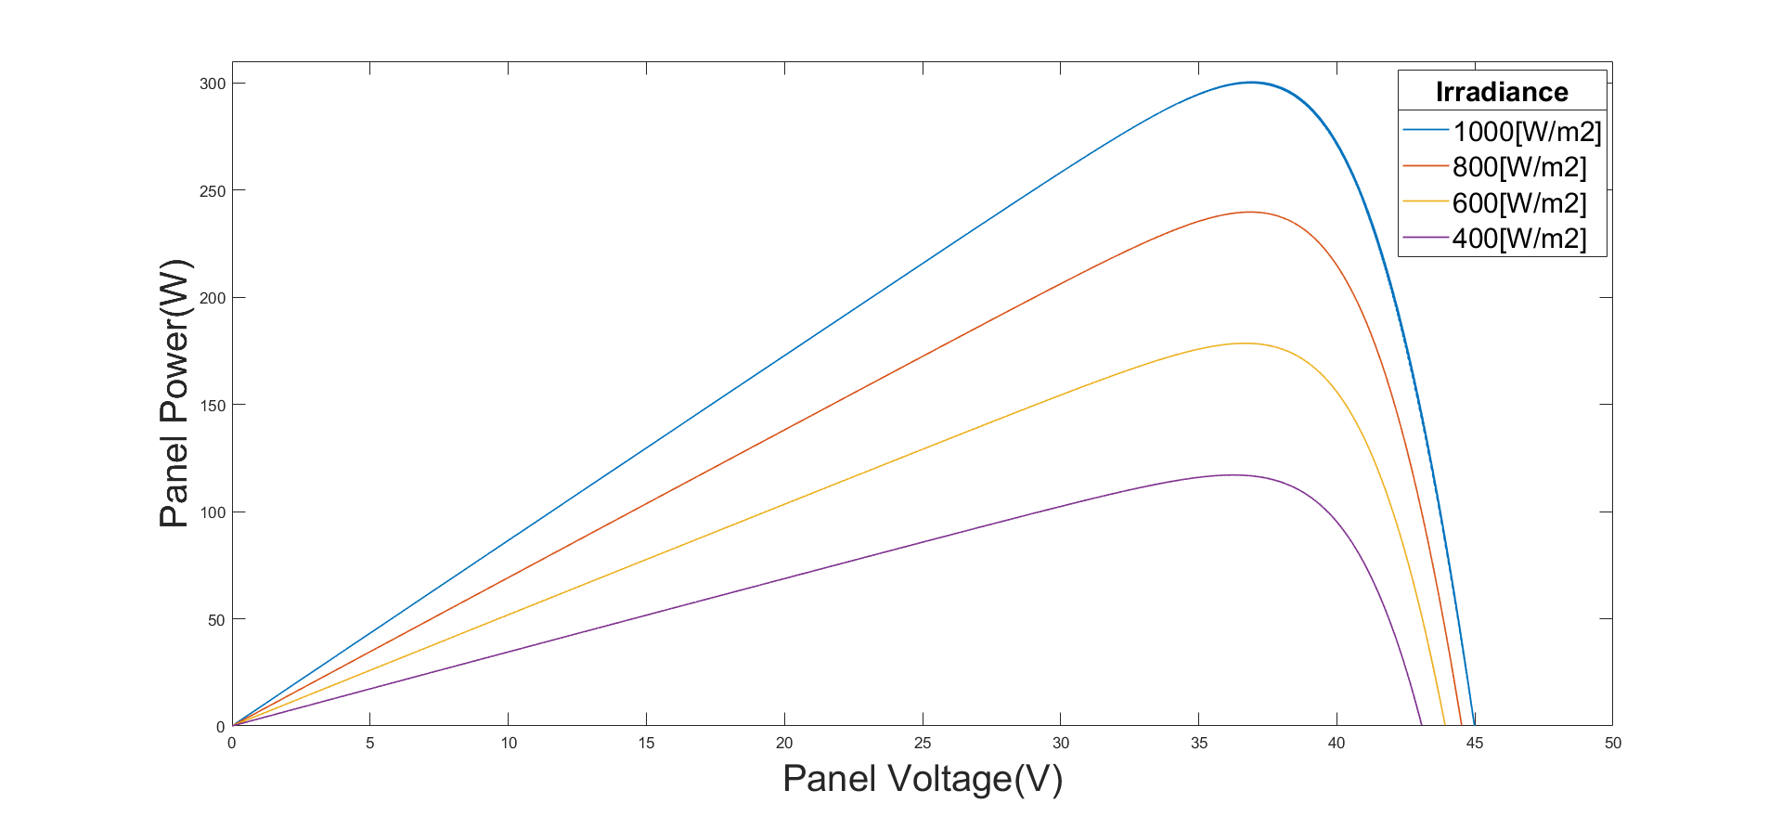
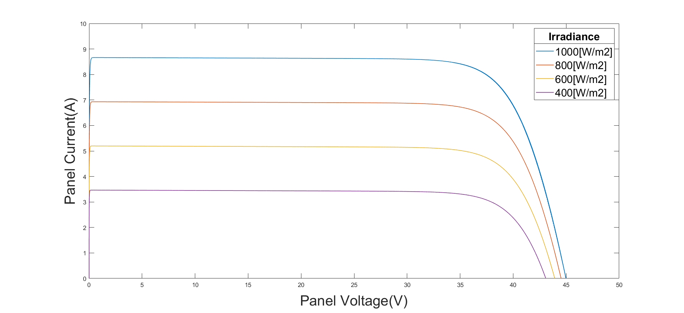
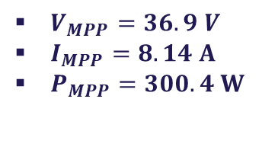
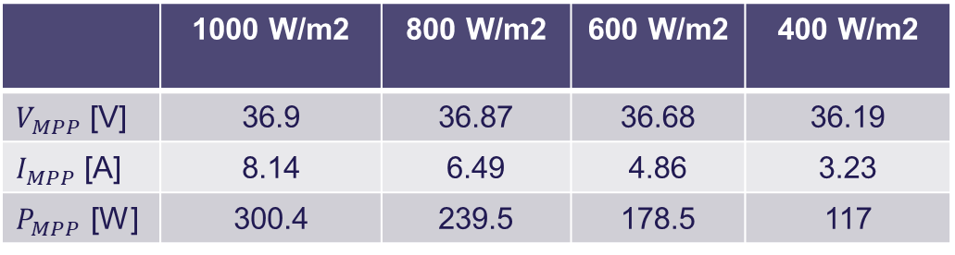
PV panel curves
$V_{MPP}=36.9 V$
$I_{MPP}=8.14 A$
$P_{MPP}=300.4 W$
Slide
of 59
Irradiance effect:
PV module datasheet (STC)
P-V curves for T=25ºC and varying irradiance.
I-V curves for T=25ºC and varying irradiance.
 | 1000 W/m2 | 800 W/m2 | 600 W/m2 | 400 W/m2
$V_{MPP}$ [V] | 36.9 | 36.87 | 36.68 | 36.19
$I_{MPP}$ [A] | 8.14 | 6.49 | 4.86 | 3.23
$P_{MPP}$ [W] | 300.4 | 239.5 | 178.5 | 117
Estefanía

Slide 39
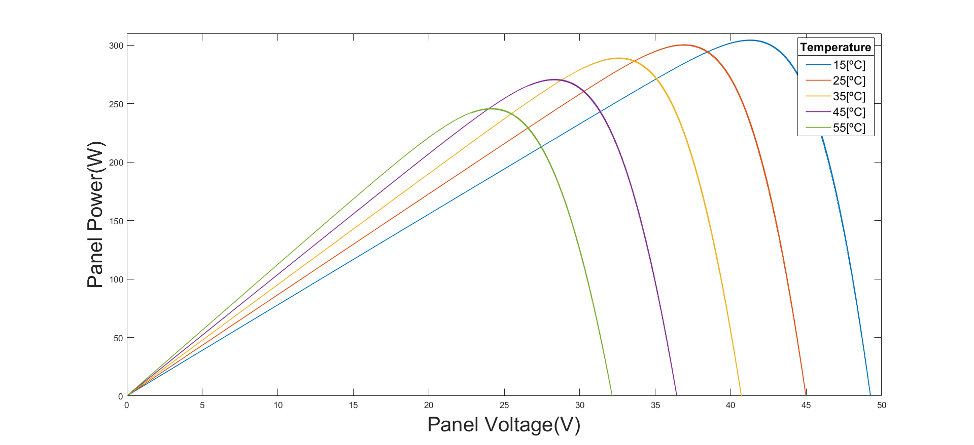
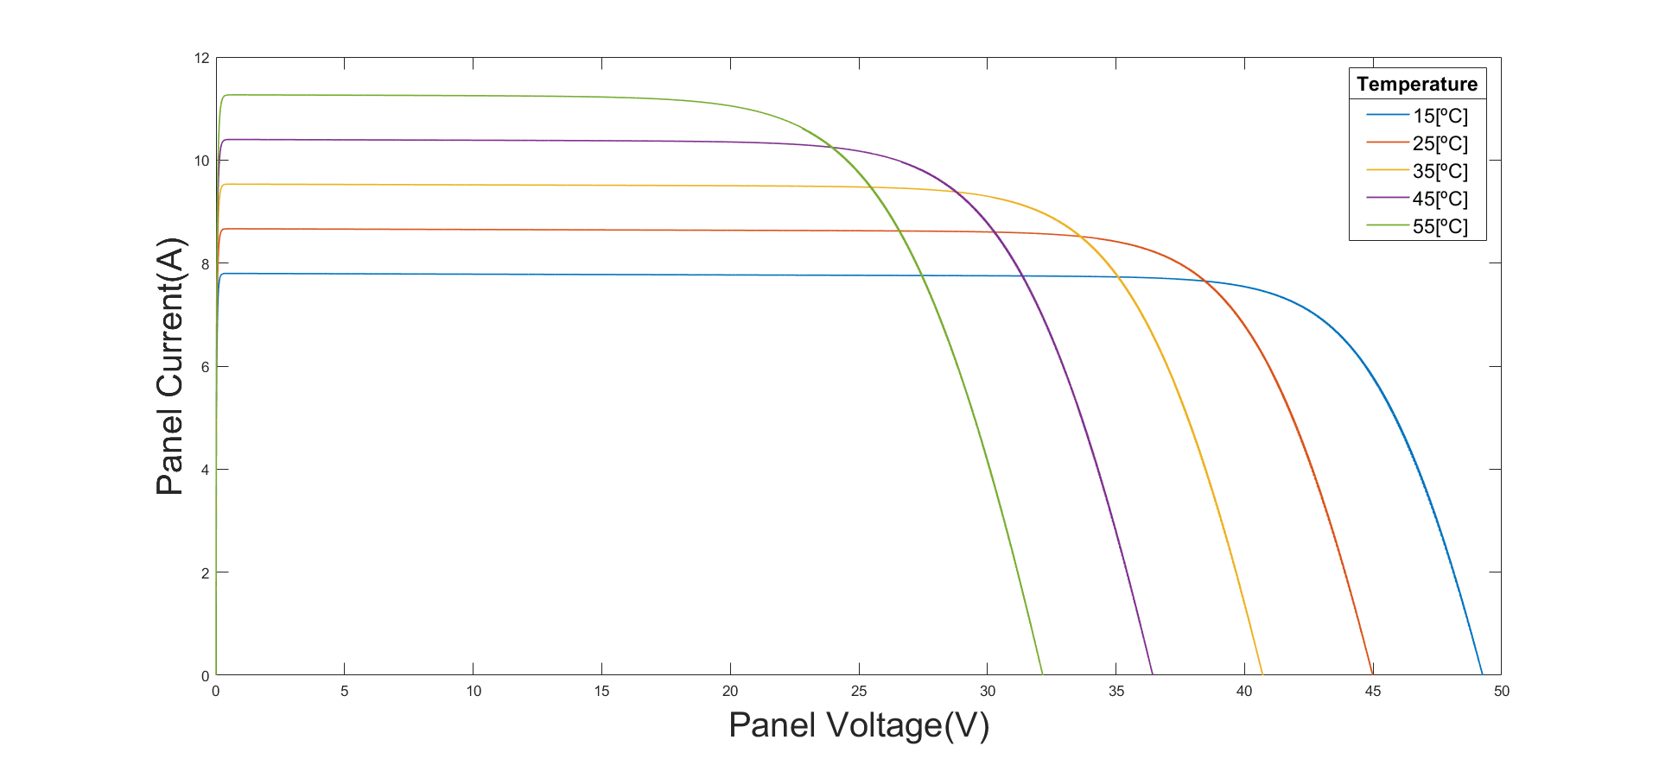
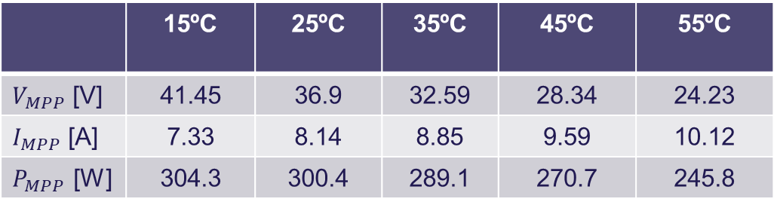
PV panel curves
Slide
of 59
Temperature effect:
P-V curves for 1000 W/m2 and varying temperature.
I-V curves for 1000 W/m2 and varying temperature.
 | 15ºC | 25ºC | 35ºC | 45ºC | 55ºC
$V_{MPP}$ [V] | 41.45 | 36.9 | 32.59 | 28.34 | 24.23
$I_{MPP}$ [A] | 7.33 | 8.14 | 8.85 | 9.59 | 10.12
$P_{MPP}$ [W] | 304.3 | 300.4 | 289.1 | 270.7 | 245.8
Estefanía

Slide 40
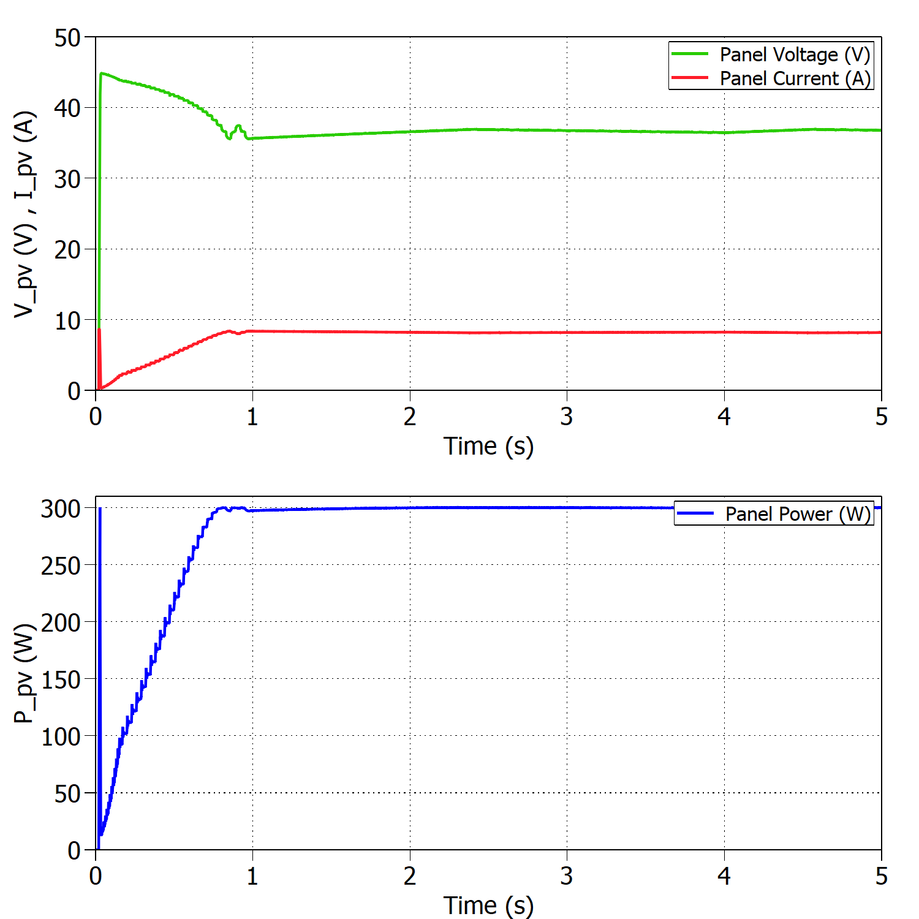
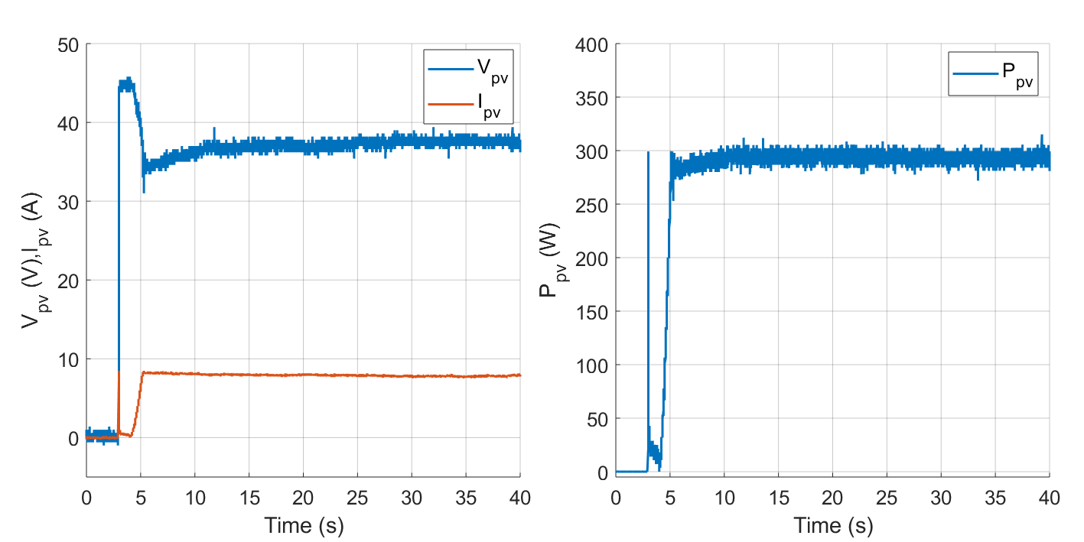


Standard Test Conditions (STC)
Slide
of 59
Buck mode:
Experimental results under STC with $V_{out}=30 V$.
$$η_{MPPTsim}=99.96\%$$
$$η_{MPPTexp}=97.72\%$$
Simulated results under STC with $V_{out}=30 V$.
Estefanía

Slide 41
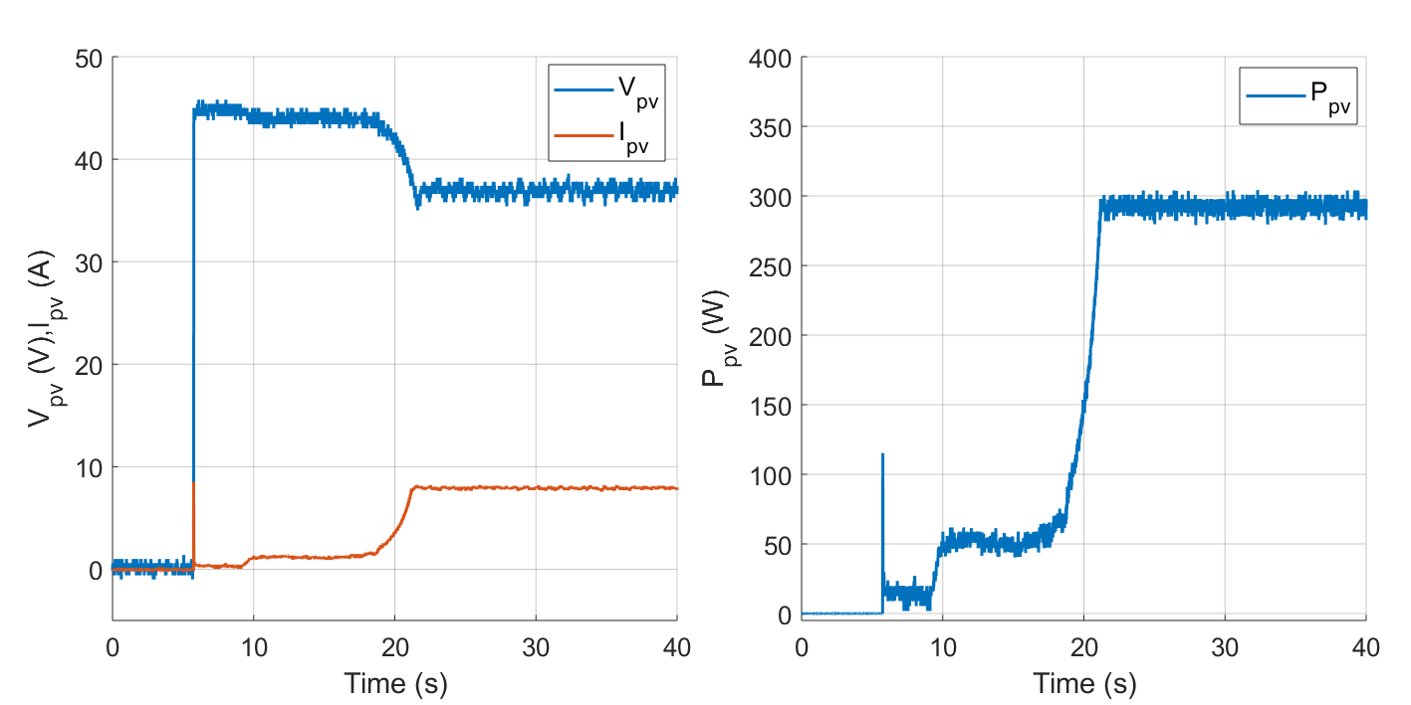
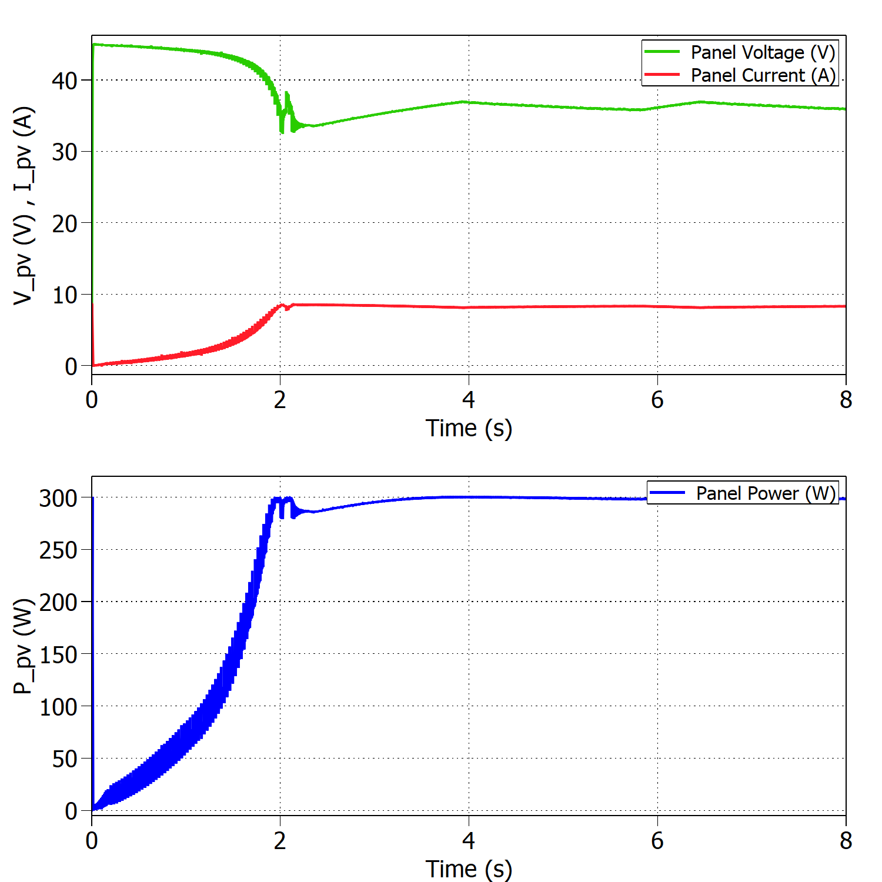


Standard Test Conditions (STC)
Slide
Boost mode:
of 59
Experimental results under STC ($V_{out}=90 V)$.
$$η_{MPPTsim}=99.82\%$$
$$η_{MPPTexp}=97.32\%$$
Simulated results under STC ($V_{out}=90 V)$.
Estefanía

Slide 42
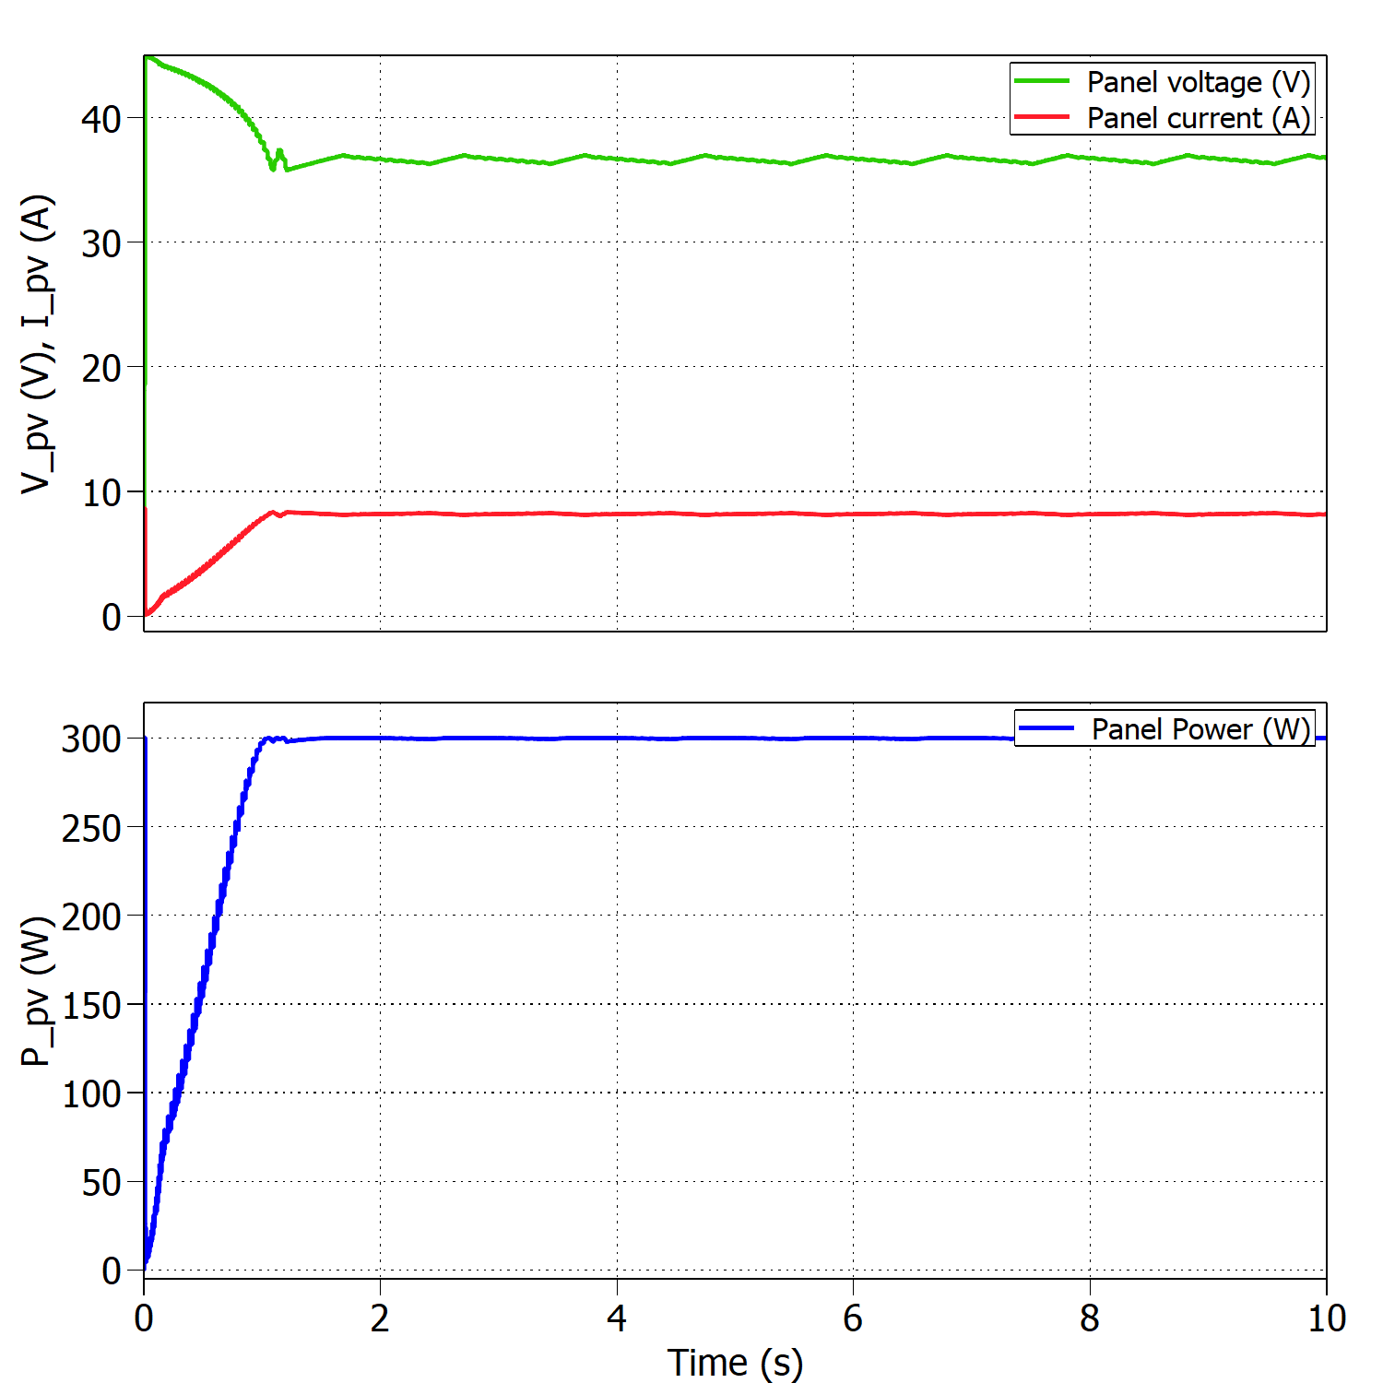
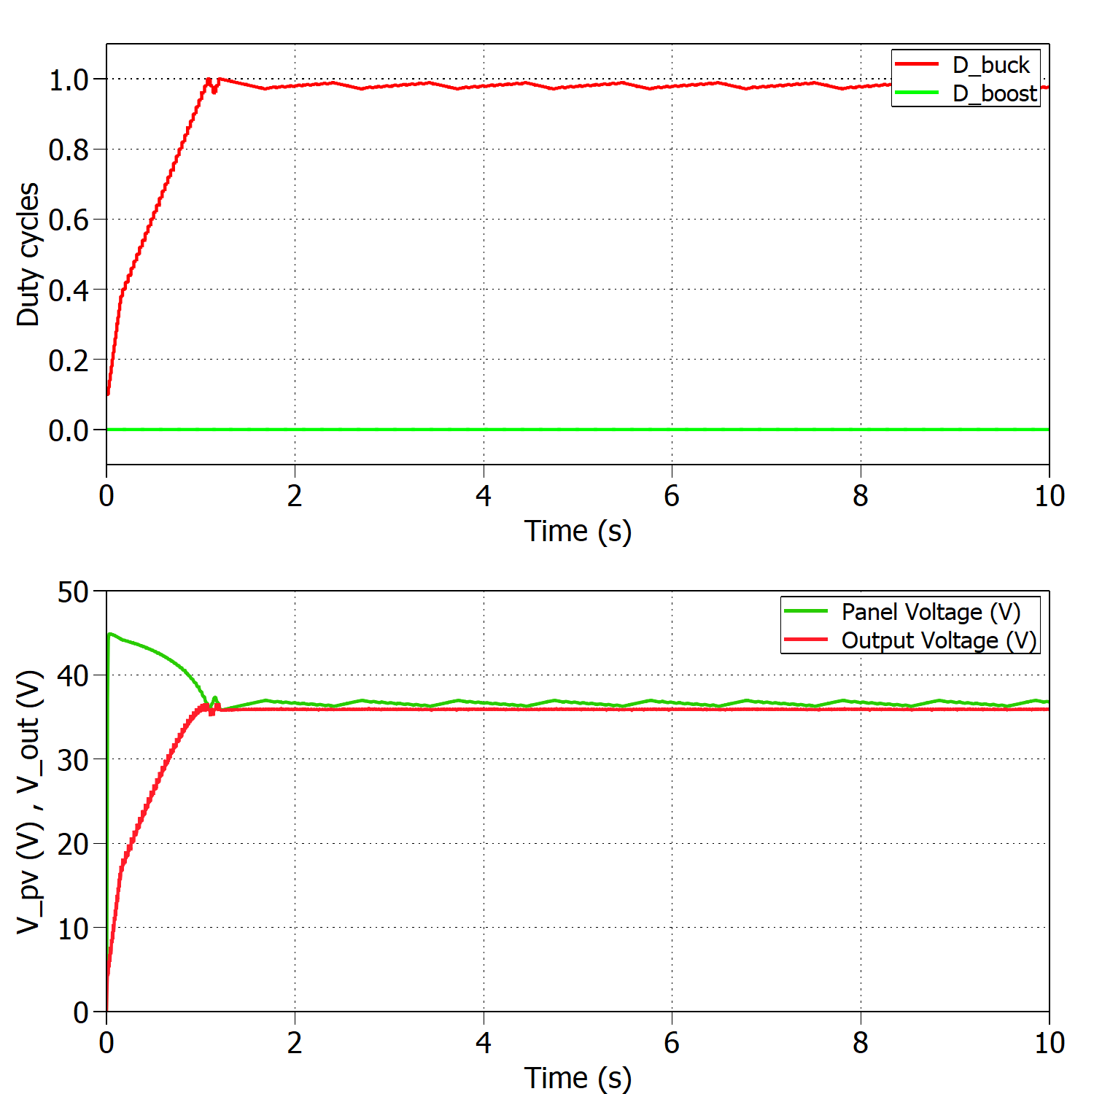

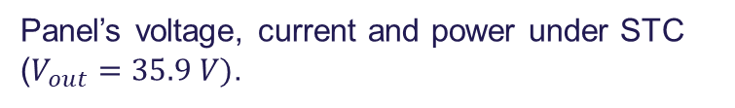
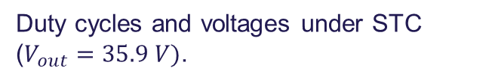
Boundary between modes of operation
Slide
of 59
Buck mode:
10 panels
$$η_{MPPT}=99.75\%$$
If T>25ºC → Boost
Panel’s voltage, current and power under STC ($V_{out}=35.9 V)$.
Duty cycles and voltages under STC ($V_{out}=35.9 V)$.
Estefanía

Slide 43





Boundary between modes of operation
Slide
of 59
Boost mode:
9 panels
$$η_{MPPT}=99.80\%$$
If T<25ºC → Buck
Panel’s voltage, current and power under STC ($V_{out}=39.8 V)$.
Duty cycles and voltages under STC ($V_{out}=39.8 V)$.
Estefanía

Slide 44




Sudden change in irradiance
Slide
of 59
Buck mode:
Experimental results for 1000 - 800 W/m2 and constant temperature T=25ºC.
Simulated results for 1000 - 800 W/m2 and constant temperature T=25ºC.
$$t_{MPPTsim}=0.5 s$$
$$t_{MPPTexp}=6.6 s$$
Estefanía

Slide 45




Sudden change in temperature
Slide
of 59
Buck mode:
Experimental results for 25 - 15 ºC and constant irradiance 1000 W/m2.
$$t_{MPPTsim}=2 s$$
$$t_{MPPTexp}=4.1 s$$
Simulated results for 25 - 15 ºC and constant irradiance 1000 W/m2.
Estefanía

Slide 46




Comparison simulation and experiments
Slide
of 59
Buck STC | Simulation | Experiment
$$η_{MPPT}$$ | 99.96% | 97.72%
$$t_{MPPT}$$ | 2 s | 10 s
Boost STC
$$η_{MPPT}$$ | 99.82% | 97.32%
$$t_{MPPT}$$ | 4 s | 21 s
Buck 1000 - 800 W/m2
$$t_{MPPT}$$ | 0.5 s | 6.6 s
Buck 25 - 15 ºC
$$t_{MPPT}$$ | 2 s | 4.1 s
Estefanía

Slide 47


Efficiency of the converter
Slide
of 59
Buck mode:
Voltages and powers at the converter’s input and output under STC.
$$η_{converter}=\frac{P_{out}}{P_{PV}} ∗100=93.15\%$$
Estefanía

Slide 48

Thermal test
Slide
of 59
Open-loop buck mode:
Inductor and heat sink temperature varying with time.
Thermal camera showing hot and cold spots in the PCB.
Estefanía

Slide 49
Discussion

Slide 50


Driver issues
Slide
of 59
[4]
Voltage spikes at gate
Nicolás

Slide 51


Driver issues
Slide
of 59
[4]
Voltage spikes removed
Nicolás

Slide 52
Voltage sensor issues
Slide
of 59
Design considered protection.
Positive peak voltage protection.
Output current limitation.
Nicolás

Slide 53

Inductor
Slide
of 59
Loss of inductance.
Temperature increase.
Nicolás

Slide 54

Software filtering
Slide
of 59
V and I measurements are noisy.
HW filtering at the output of the sensor is not enough.
Single pole LPF implemented.
Nicolás

Slide 55
Future work
Slide
of 59
Hardware improvements.
Inductor design.
PCB optimization.
Converter’s efficiency.
V/I controller.
Thassilo

Slide 56
Conclusion

Slide 57

Thank you for your attention
Questions?
[5]

Slide 58
References
[1] http://www.safegardgroup.com/blog/2017/07/27/solar-panel-disposal
[2] https://www.dgem.nl/nl/zonne-energie/opbrengstvariabelen-zonnepanelen
[3] http://www.alternative-energy-tutorials.com/energy-articles/solar-cell-i-v-characteristic.html
[4] MOSFET Gate Drive Circuit, Toshiba, 2018
[5] https://www.thermofisher.com/blog/mining/mining-metals-for-a-renewable-energy-future/

